Slide 1

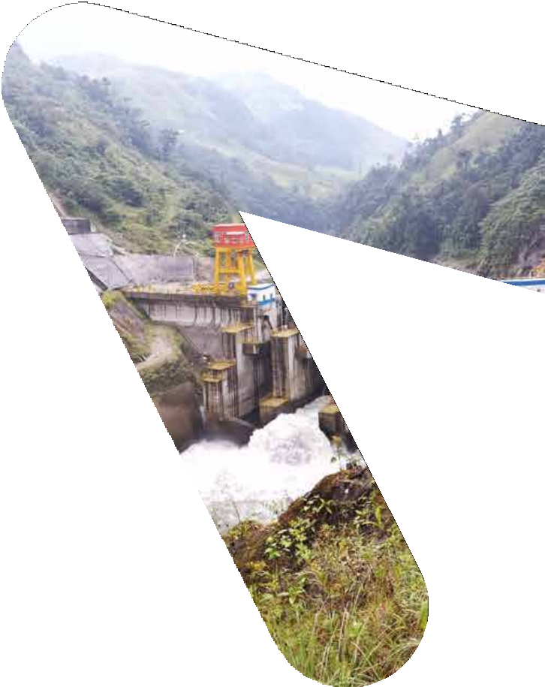



Ministry of Energy and Mines
Houston | October 2022

Slide 2
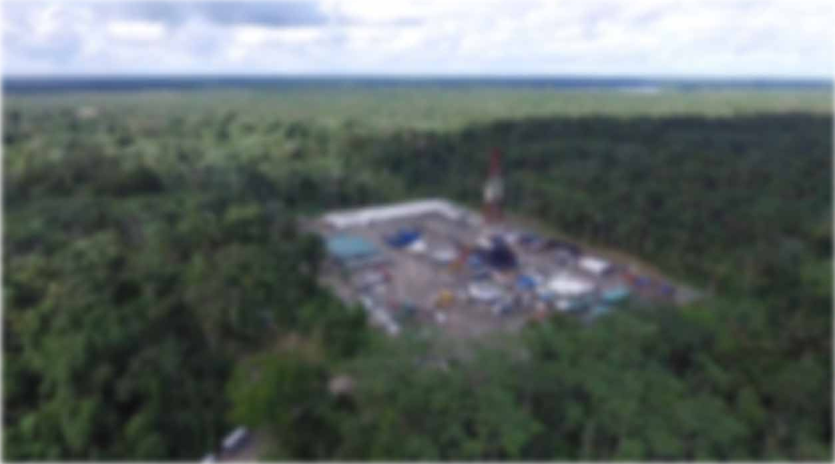

Ecuador’s
Oil and Gas
Industry

Slide 3
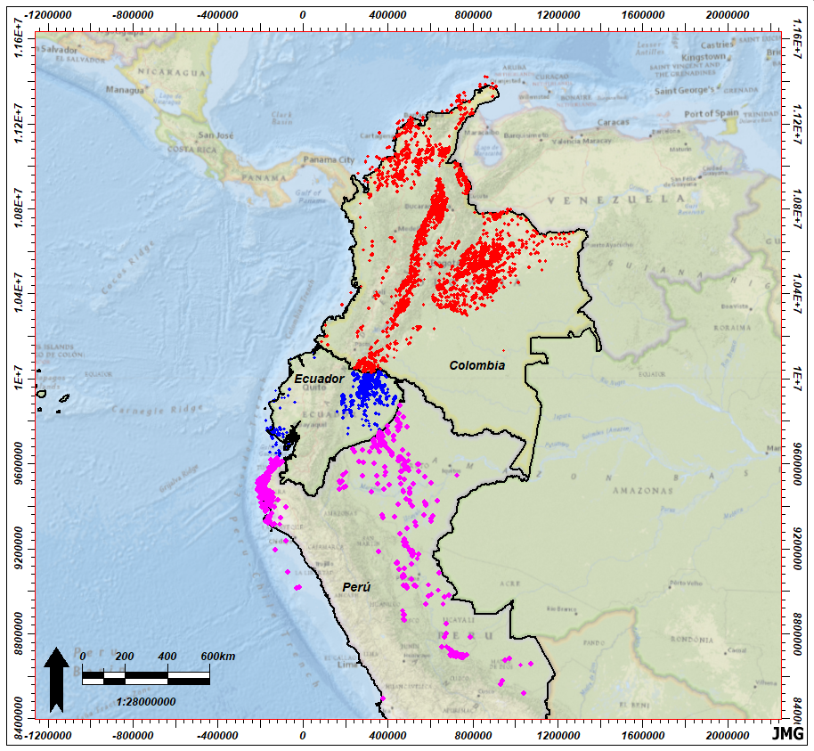

Llanos Basin - COL:
570 MBOPD – 8,879 wells
~55,800 K Acres
Oriente Basin ECU:
490 MBOPD – 4,652 wells
~9,600 K Acres
Ecuador has the most prolific oil basin in the P C E region
Maranon Basin PER:
18 MBOPD – 590 wells
~92,700 K Acres
Notes:
Oriente Basin - Ecuador
North-Central Zone
(current productive area)
Still to develop
Pungarayacu (biggest OOIP)
Recent Exploration Intracampos I
Ongoing Intracampos II process
No Field Optimization and new exploration prospects
Southeast Zone

Slide 4
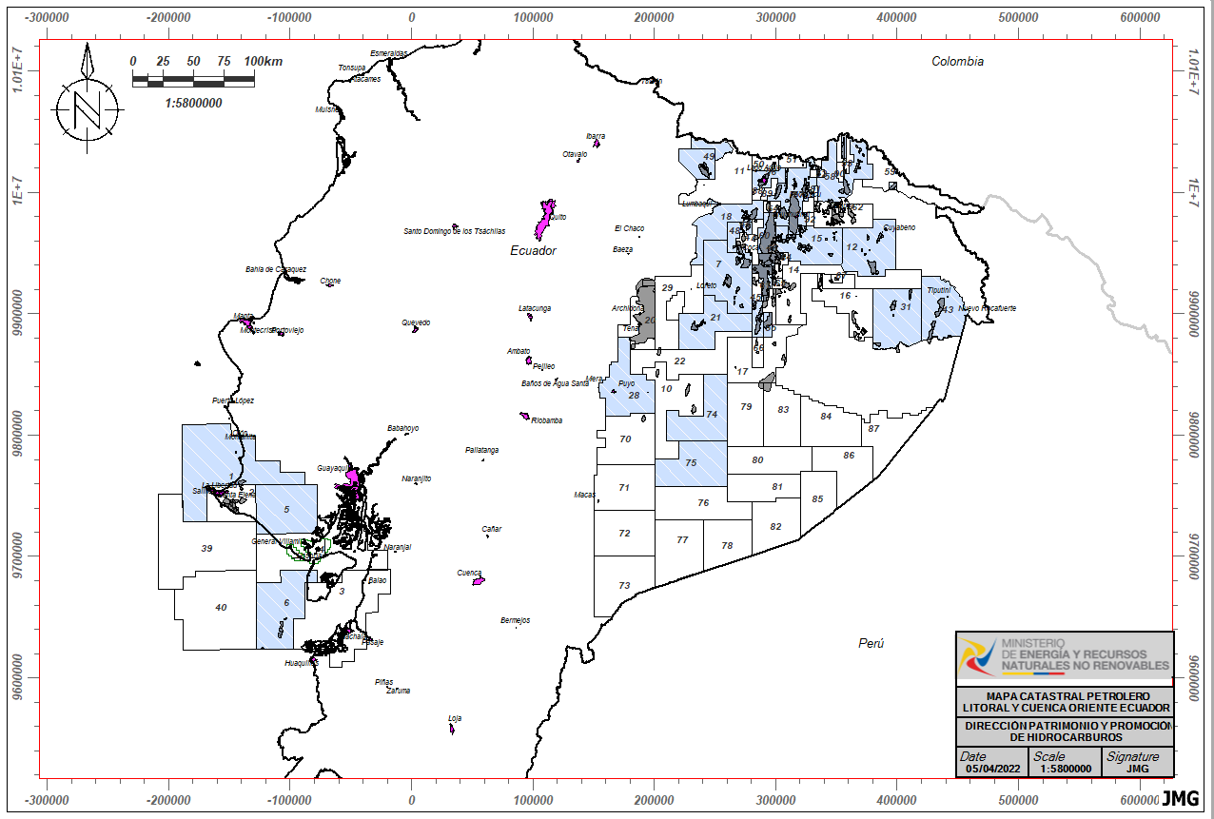
BLOCKS OPERATED BY NOC PETROECUADOR
PETROECUADOR
Total Blocks: 25
Blocks with Activity: 19
Blocks to be developed: 6
Avg. daily production: 380 MBOPD
Notes:
Estimated investment of 1100 MM USD.
Hydrocarbon activities in strict compliance with environmental regulations.
Generation of direct and indirect jobs.
Revitalization of the local economy and strengthening of productive activities.
Social development projects for the benefit of the communities.

Slide 5
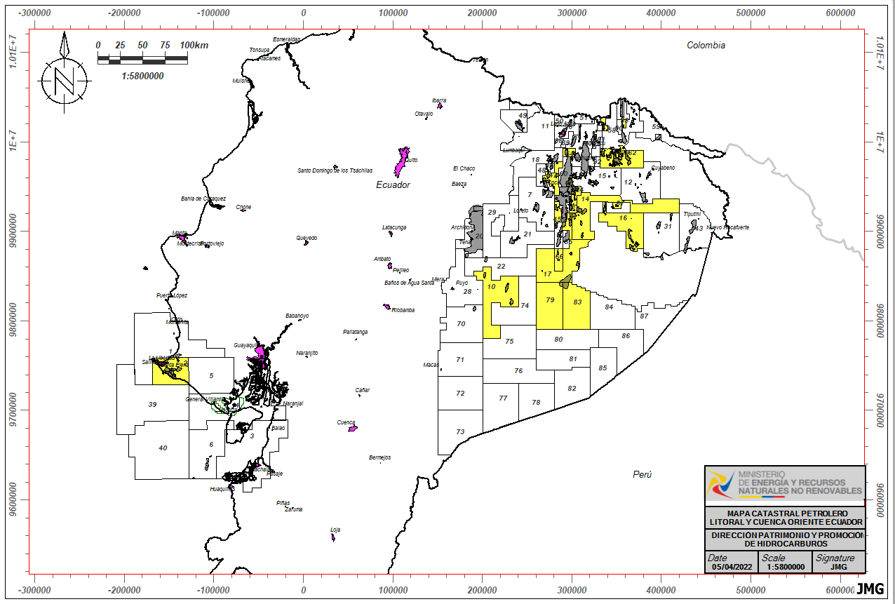
BLOCKS OPERATED BY PRIVATE COMPANIES
Private Companies
Total Blocks: 25
Blocks with Activity: 21
Blocks to be developed: 4
Avg. daily production: 110 MBOPD
Total Ecuador production¹: 490 MBOPD
¹Average actual production for Sep. 2022
Notes:
Estimated investment of 1100 MM USD.
Hydrocarbon activities in strict compliance with environmental regulations.
Generation of direct and indirect jobs.
Revitalization of the local economy and strengthening of productive activities.
Social development projects for the benefit of the communities.

Slide 6
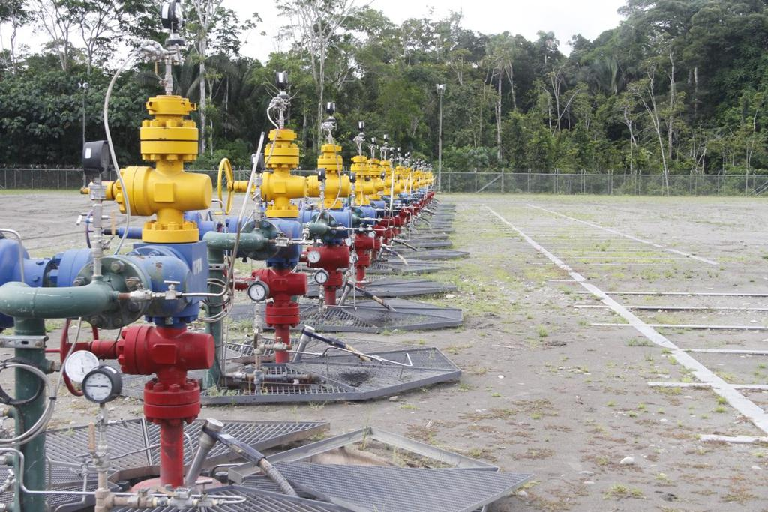
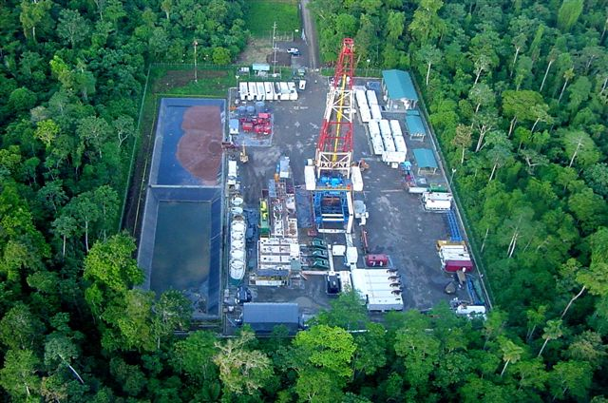
FOCUS ON MINIMIZATION OF ENVIRONMENTAL IMPACT
Notes:
Estimated investment of 1100 MM USD.
Hydrocarbon activities in strict compliance with environmental regulations.
Generation of direct and indirect jobs.
Revitalization of the local economy and strengthening of productive activities.
Social development projects for the benefit of the communities.

Slide 7
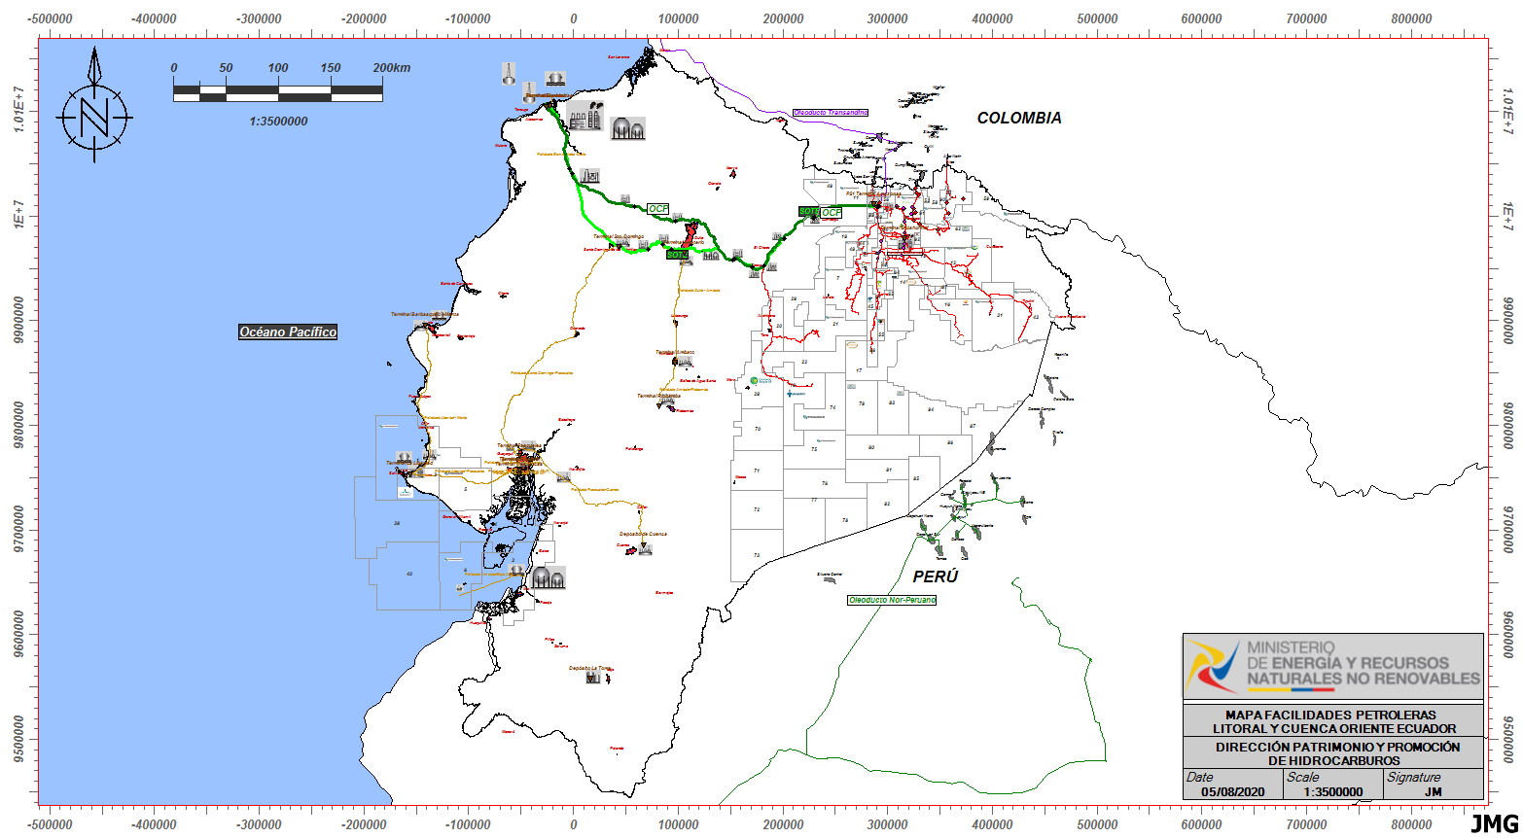
MIDSTREAM INFRASTRUCTURE NETWORK WITH SPARE CAPACITY
OCP Pipeline
MAXIMUM CAPACITY: 450 MBOPD
CURRENT USE: 154 MBOPD
SOTE Pipeline
MAXIMUM CAPACITY: 360 MBOPD
CURRENT USE: 357 MBOPD
OFFSHORE GAS / CAMPO AMISTAD
MAXIMUM PIPELINE CAPACITY: 100 MCFD
CURRENT USE: 25 MCFD
CRUDE TYPE: NATURAL GAS
Notes:
Estimated investment of 1100 MM USD.
Hydrocarbon activities in strict compliance with environmental regulations.
Generation of direct and indirect jobs.
Revitalization of the local economy and strengthening of productive activities.
Social development projects for the benefit of the communities.

Slide 8
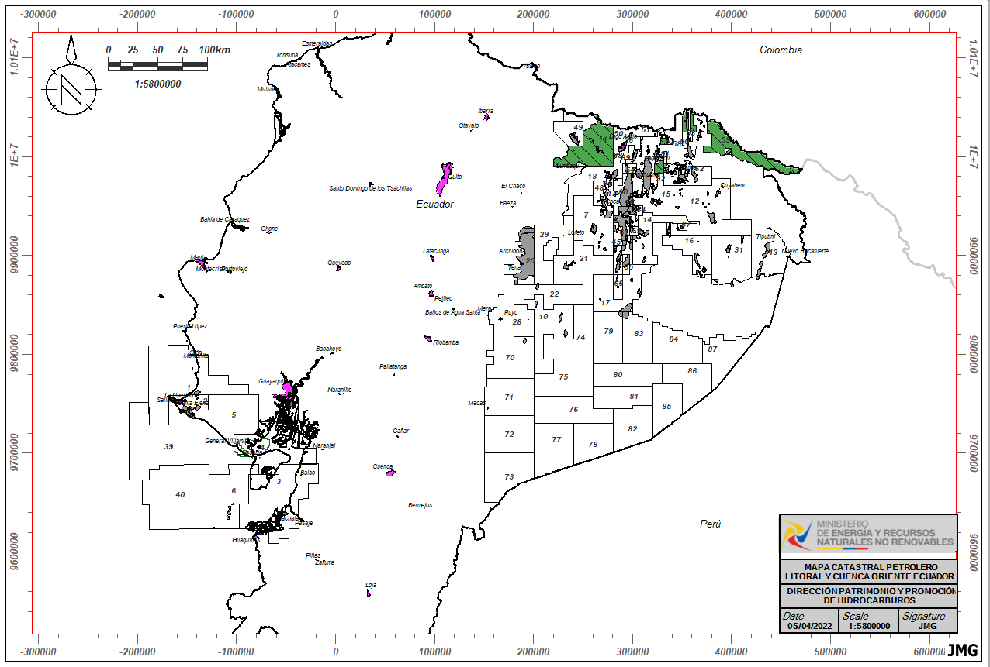
INTRACAMPOS II BIDDING ROUND
Blocks Intracampos II
Total Blocks: 6
Blocks with Initial Exploration: 1
Blocks without Initial Exploration: 5
Estimated avg. daily production:
18 -24 MBOPD
Notes:
Estimated investment of 1100 MM USD.
Hydrocarbon activities in strict compliance with environmental regulations.
Generation of direct and indirect jobs.
Revitalization of the local economy and strengthening of productive activities.
Social development projects for the benefit of the communities.

Slide 9





Welcome to a world
Ecuador
of opportunities that
offers to
Foreign Investors

Slide 10
¡Thank You!

