Slide 1

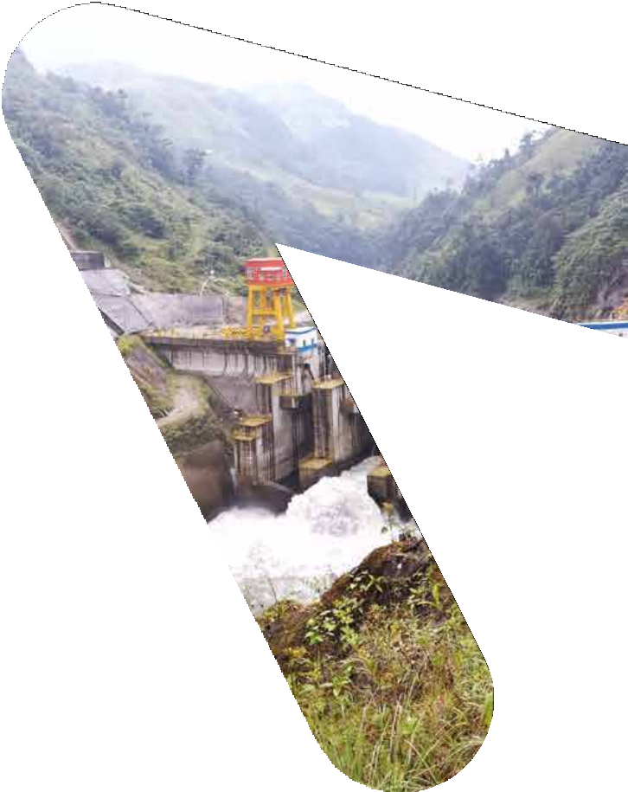



Ministry of Energy and Mines
Houston | October 2022

Slide 2
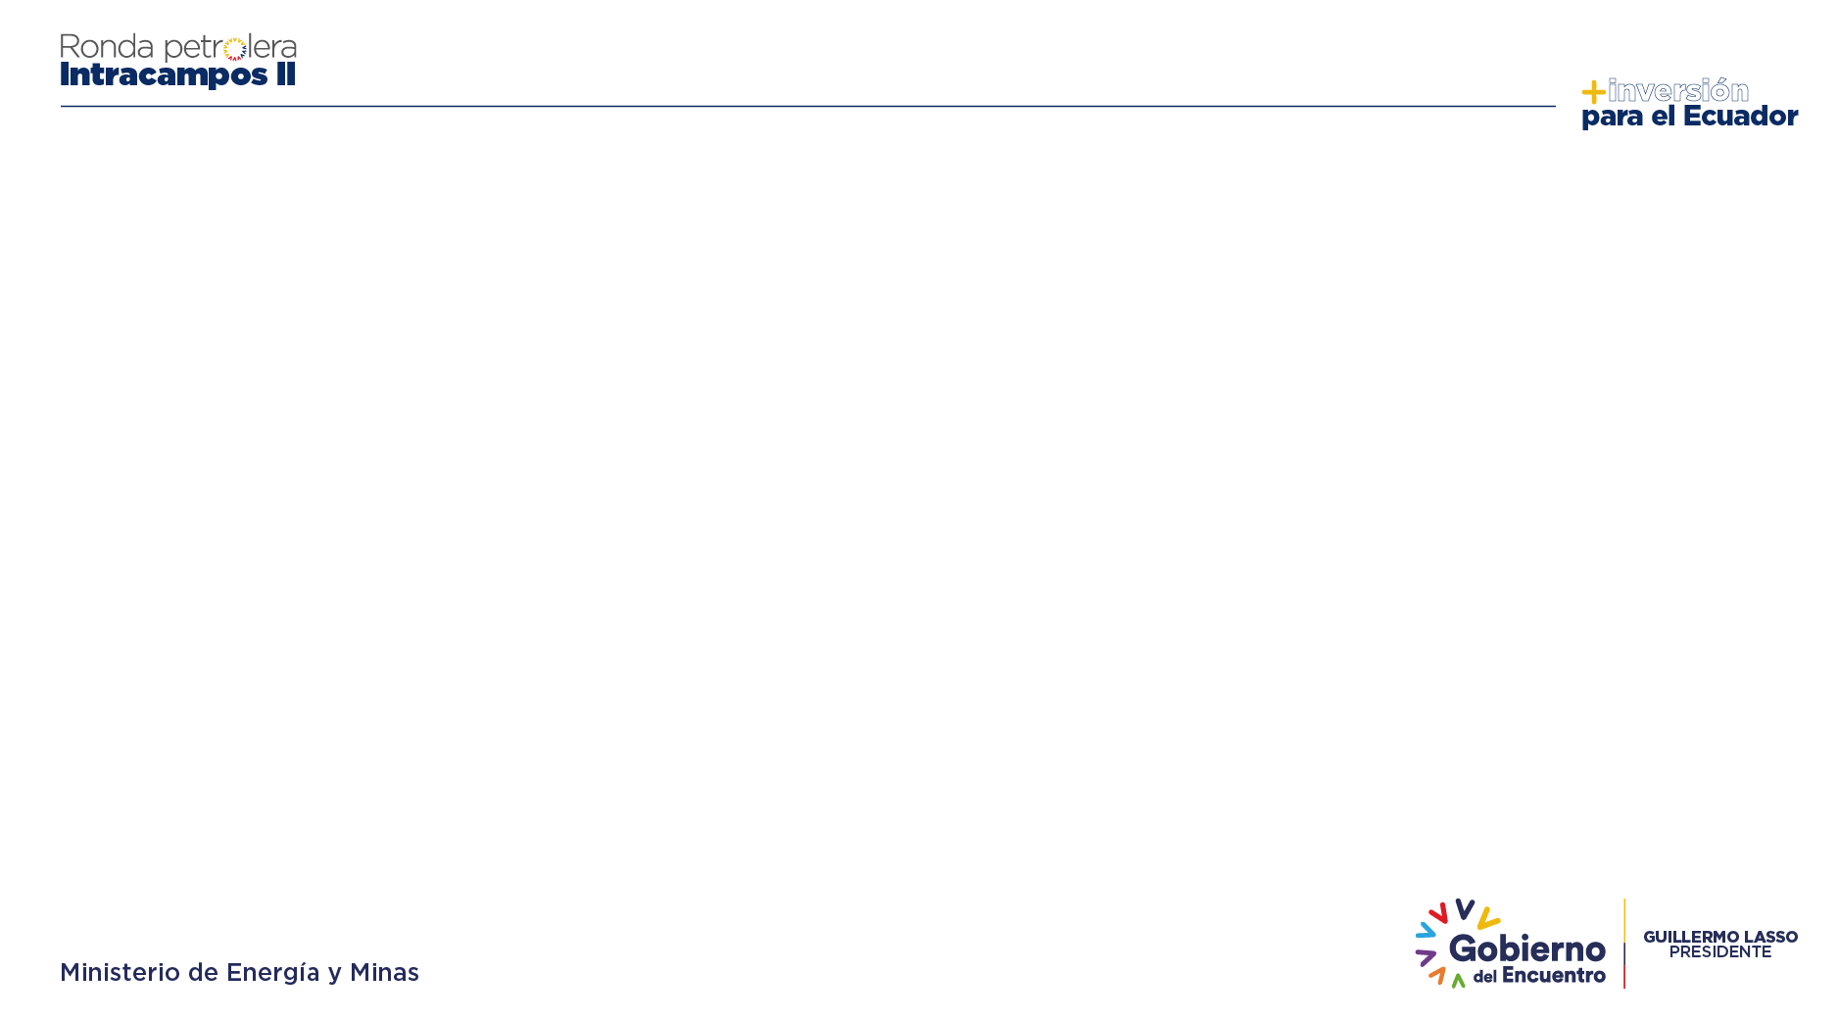




XIII RONDA LICITATORIA: INTRACAMPOS II
They are located in the northern part of the Oriente Basin, in the Province of Sucumbíos, which corresponds to an oil area with high hydrocarbon potential and with surface conditions such as pre-existing infrastructure and a developed oil services industry (airports, roads, pipeline network, navigable rivers, etc.).
The Oriente Basin is one of the most productive petroleum systems in South America. Several of these blocks have subsurface information such as: 2D and 3D seismic, nearby oil wells, production data from analogous fields and other geological studies.
2
The Intracampos II Round, corresponds to 6 blocks, mainly exploratory blocks called: Lumbaqui Block, Saywa Block, Tamya Block, Tetete Sur Block, VHR East Block and VHR West Block (Certification of Coordinates, Certification of No Intersection with Protected Areas).
These are areas with hydrocarbon accumulation potential that are located between fields in current development and production of several layers in the subsurface, with conventional sandstone reservoirs but also limestone reservoirs.

Slide 3
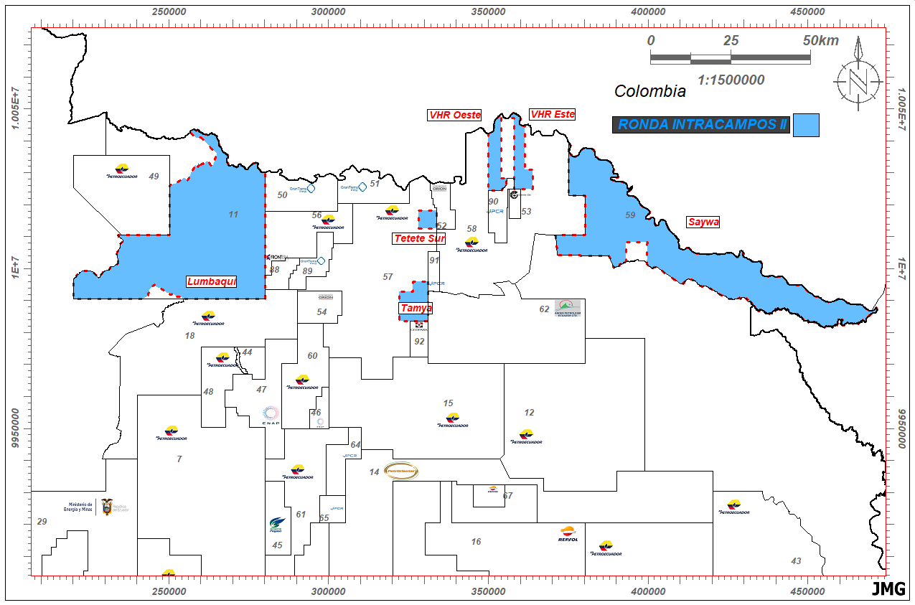
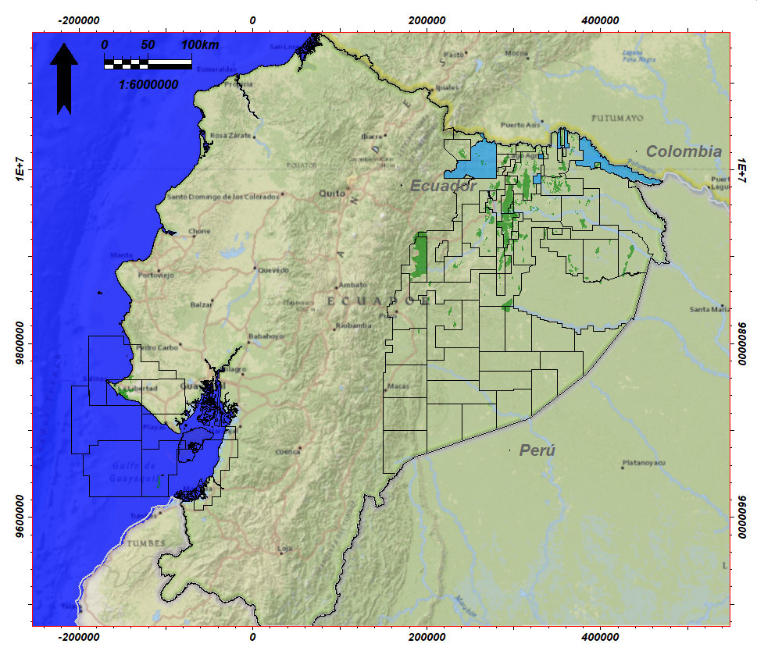
GEOGRAPHICAL LOCATION
ROUND BLOCKS INTRACAMPOS II

Slide 4
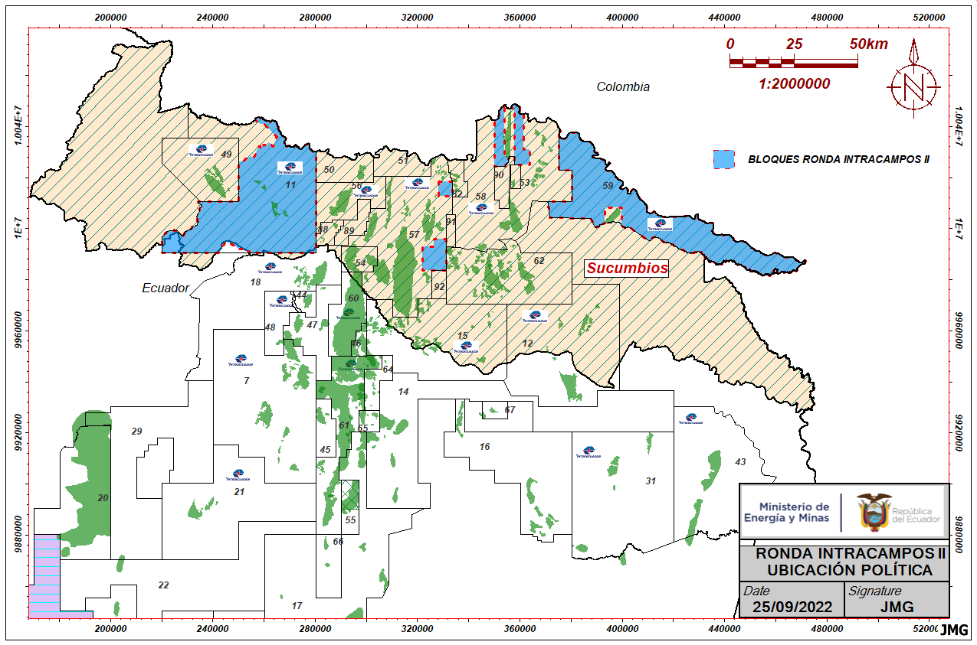
POLITICAL LOCATION
BLOCKS INTRACAMPOS II
BLOCKS:
LUMBAQUI
SAYWA
TAMYA
VHR ESTE
VHR OESTE
TETETE SUR
4

Slide 5
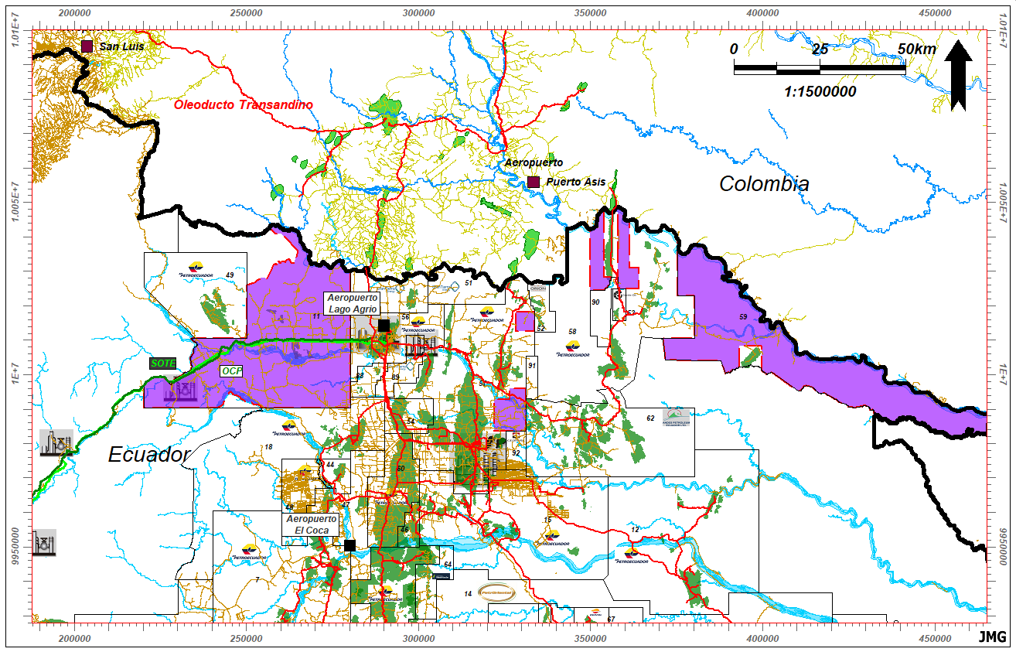
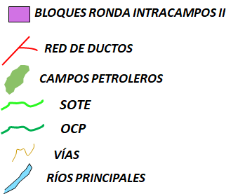
LOGISTICS AND SURFACE FACILITIES BLOCKS INTRACAMPOS II
5

Slide 6


LUMBAQUI BLOCK

Slide 7
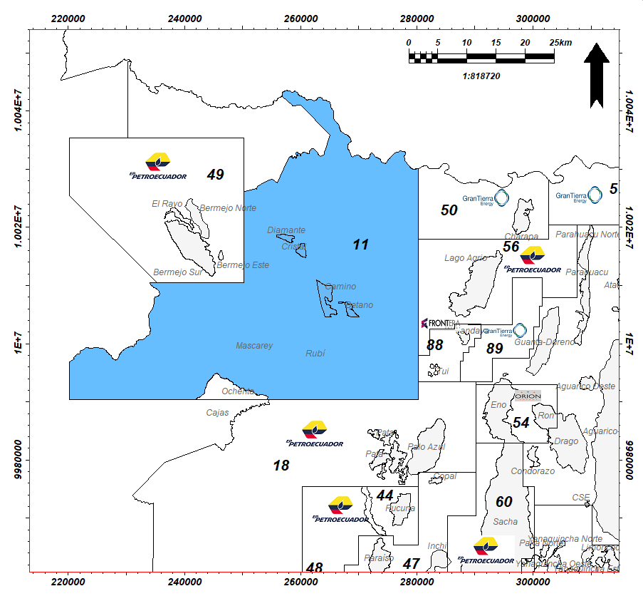

LUMBAQUI BLOCK
7
Location: Northwest of the Oriente Basin between Blocks 49, 56 and 18.
Approximate area: 167,491.5 Ha.
Prospective reservoirs: Hollín (Upper and Lower), Basal Tena, U Sandstone, T Sandstone.
Prospects: Cedro, Roble, Cristal Este, Canelo, Rubí Este, Ochenta-Mascarey.
Estimated POES:164.14 MMbls
Estimated Prospective Resources: 24.63 MMbls
Estimated Contingent Resources: 17.78 MMbls
Expected API: 26 - 31°.
Existing wells: 10
Accumulated production: 256.7 Mbls (December 31, 2006)

Slide 8
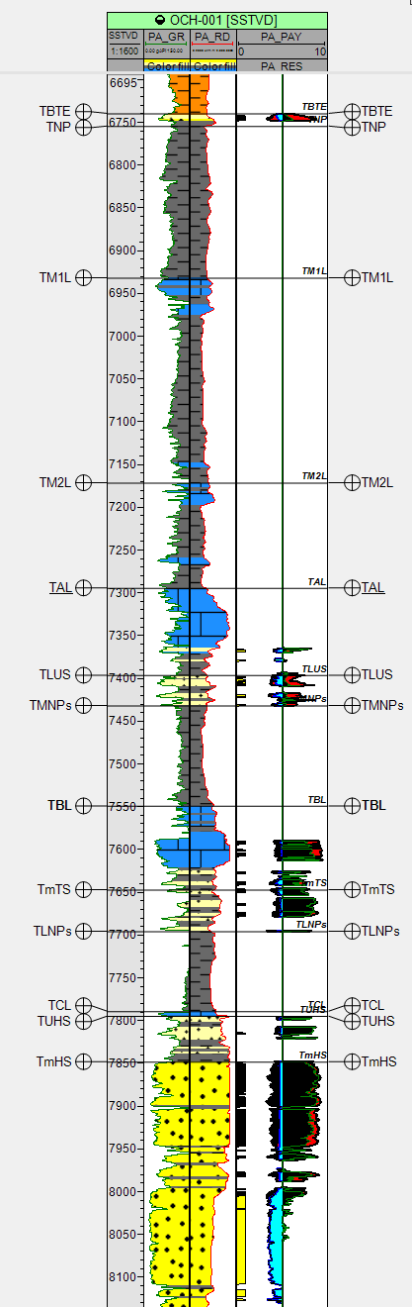
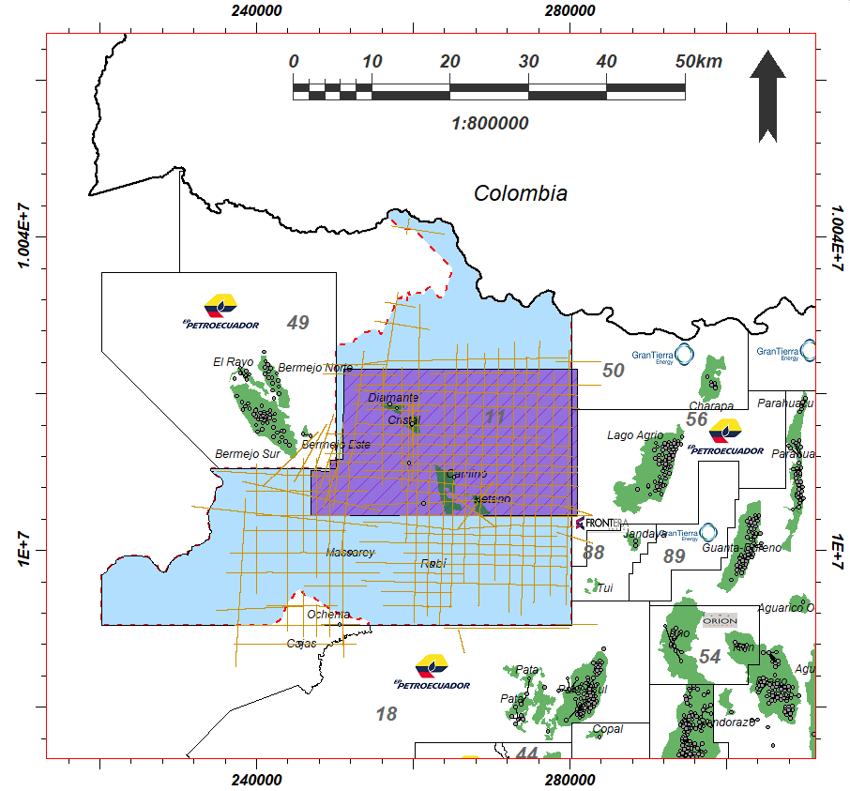
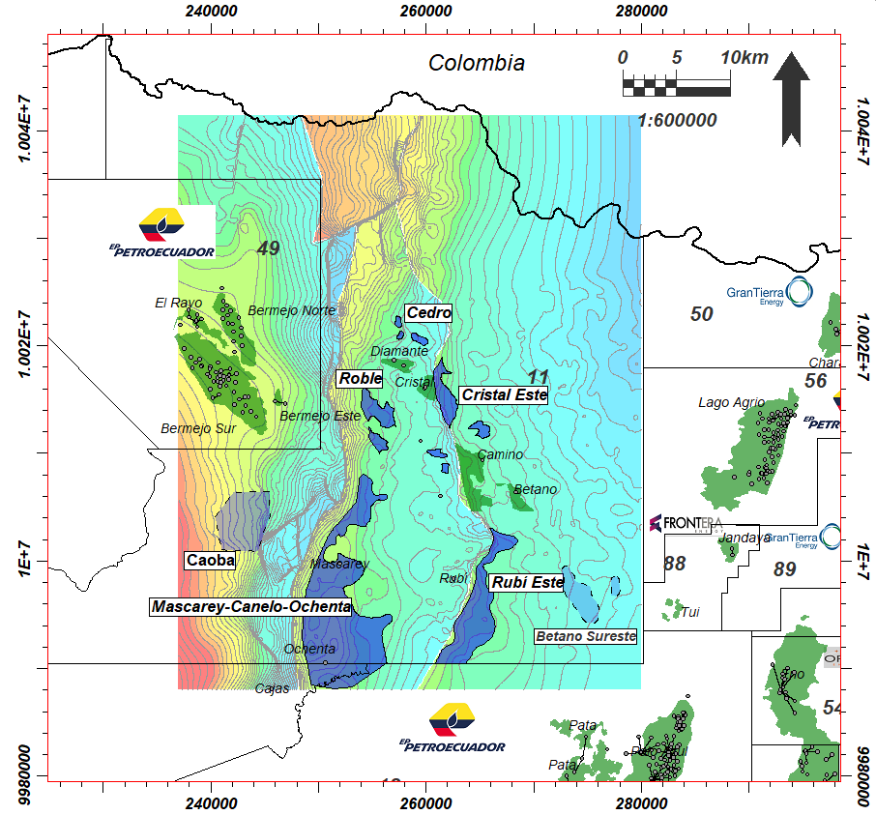
LUMBAQUI BLOCK
TYPE WELL
8
2D SEISMIC LINES and 3D SEISMIC CUBE
STRUCTURAL DISTRIBUTION

Slide 9
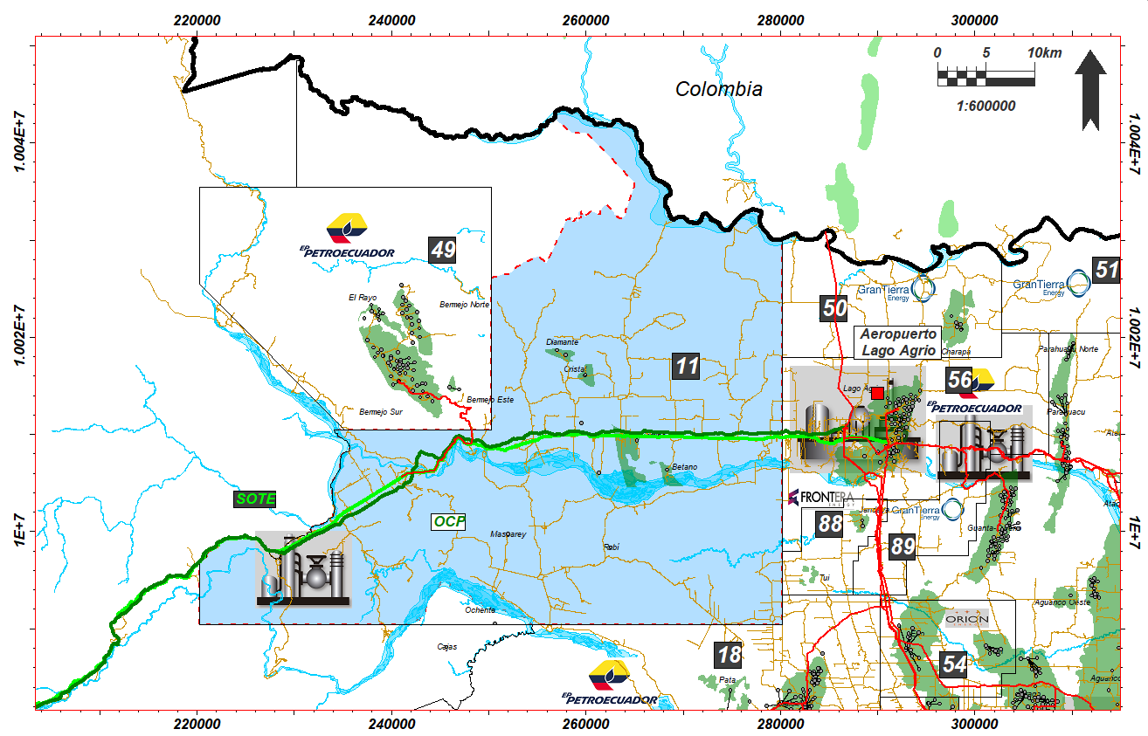
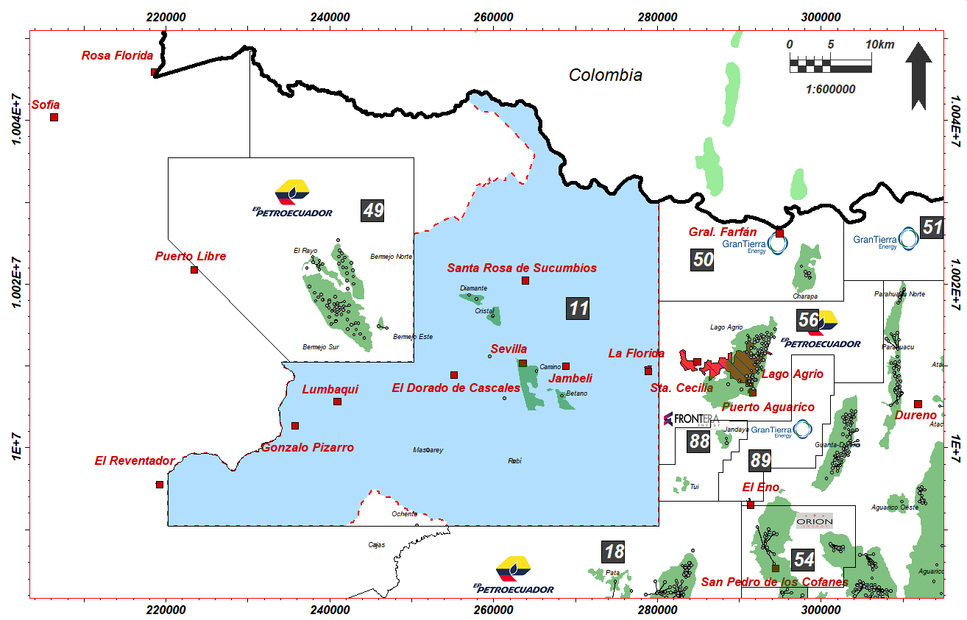
LUMBAQUI BLOCK
LOGISTICS AND SURFACE FACILITIES
TOWNS AND COMMUNITIES

Slide 10
SAYWA BLOCK

Slide 11
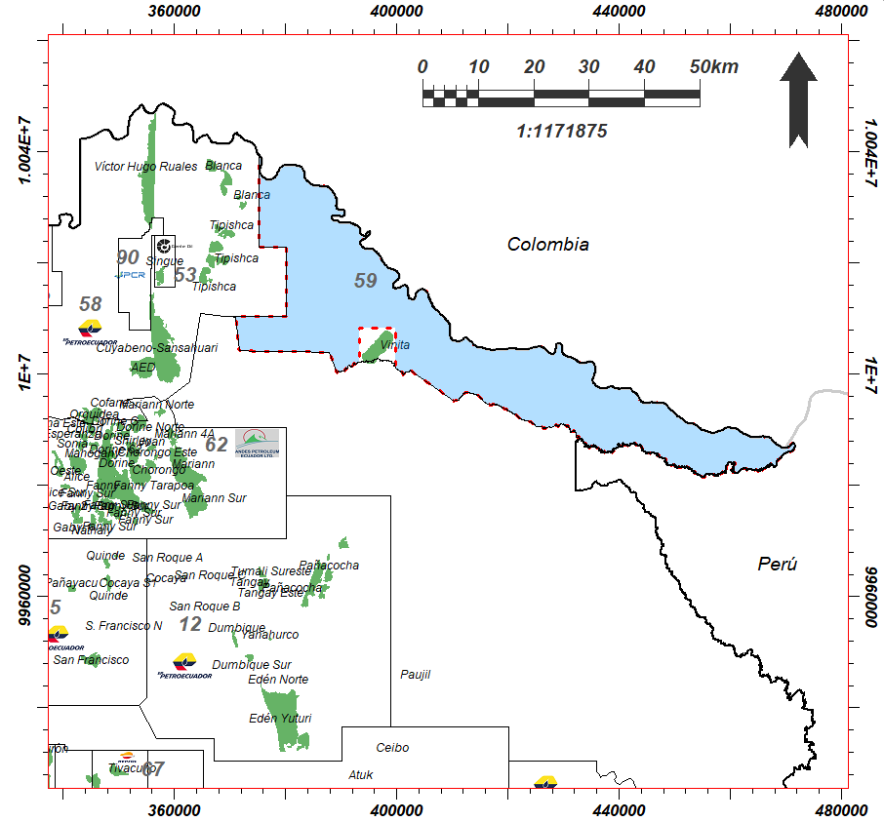

SAYWA BLOCK
11
Location: Northeast of the Oriente Basin next to Block 58, border with Colombia.
Approximate area: 133,519.6 Ha.
Prospective reservoirs: M-1 Sandstone, M-2 Sandstone, Upper U Sandstone.
Prospects: Saywa, Saywa Norte, Vinita Norte, Kipa.
Estimated POES: 150.25 MMbls
Estimated Prospective Resources: 18.15 MMbls
Expected API: 14°- 17°.
Existing wells: 1

Slide 12
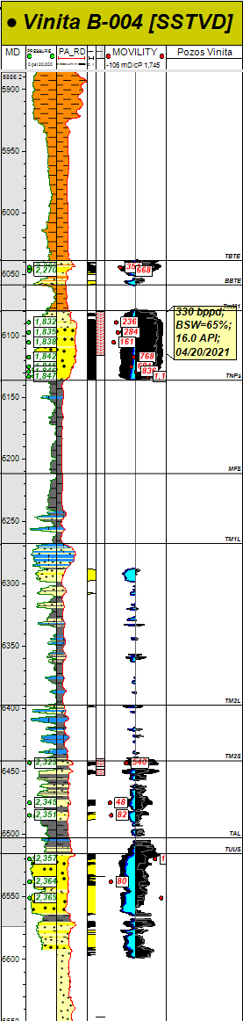
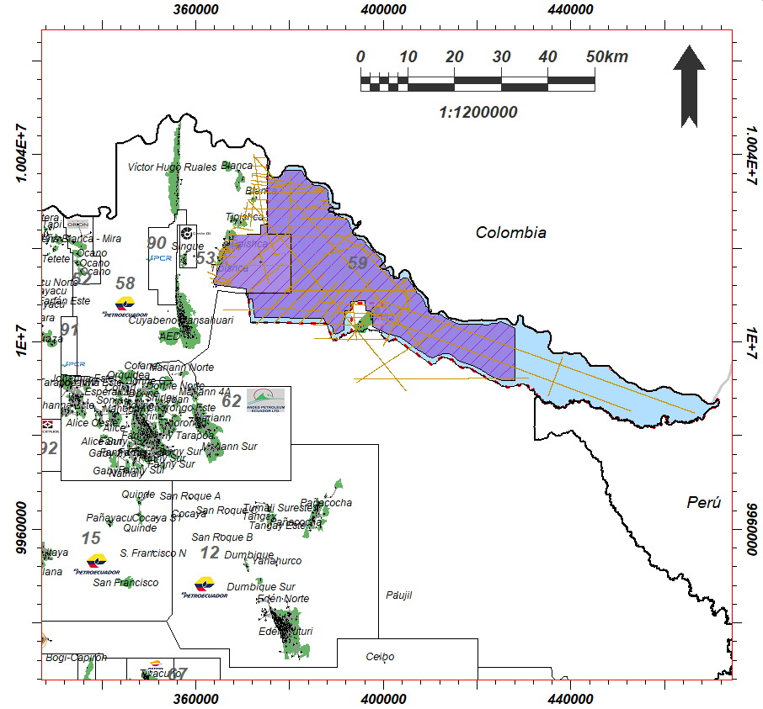
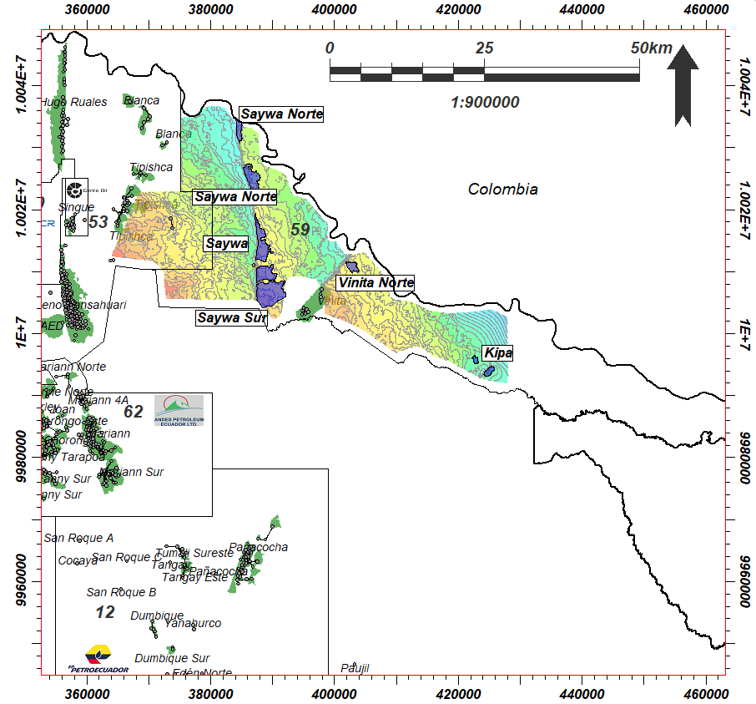
SAYWA BLOCK
TYPE WELL
12
2D SEISMIC LINES and 3D SEISMIC CUBE
STRUCTURAL DISTRIBUTION

Slide 13
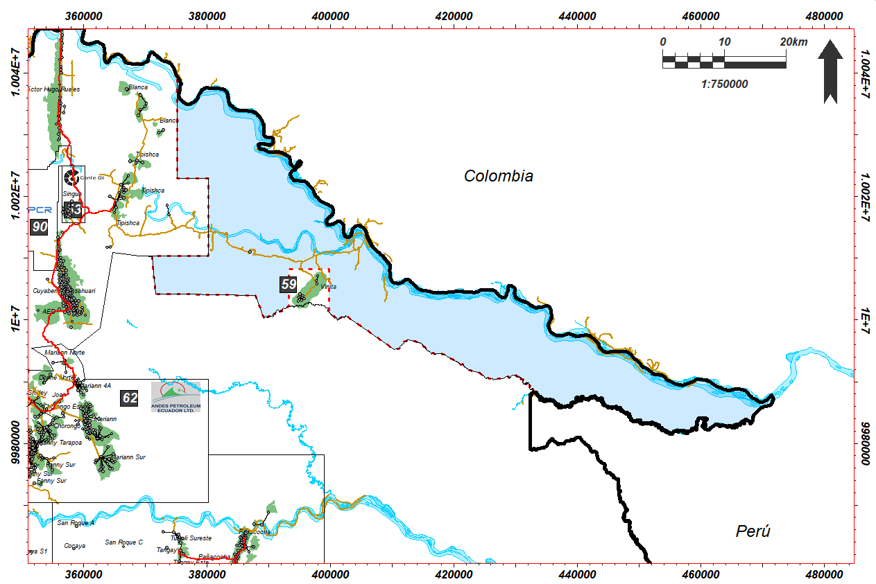
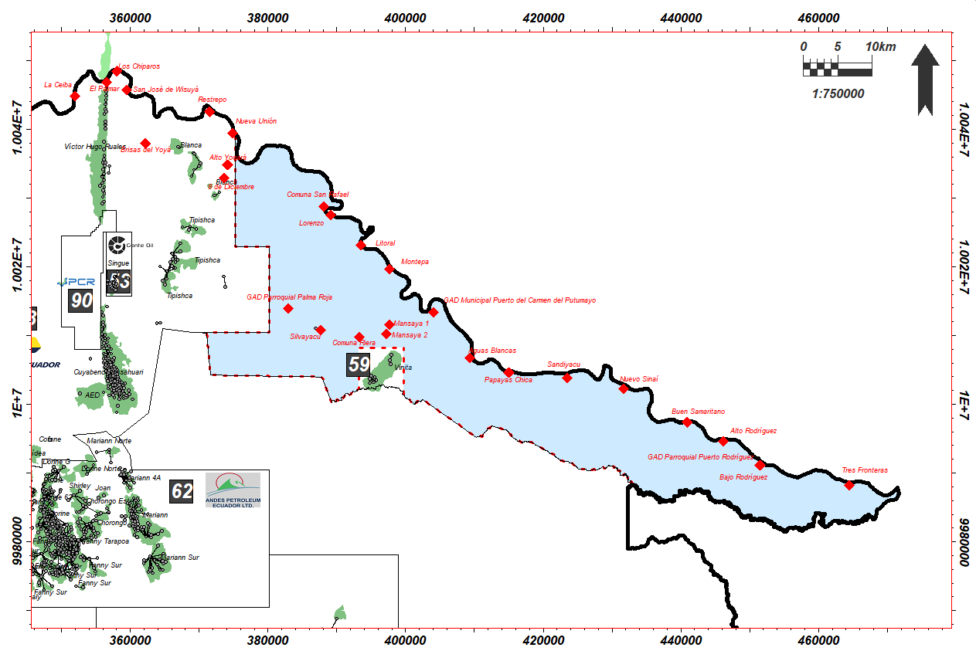
SAYWA BLOCK
13
LOGISTICS AND SURFACE FACILITIES
TOWNS AND COMMUNITIES # 18

Slide 14
TAMYA BLOCK

Slide 15
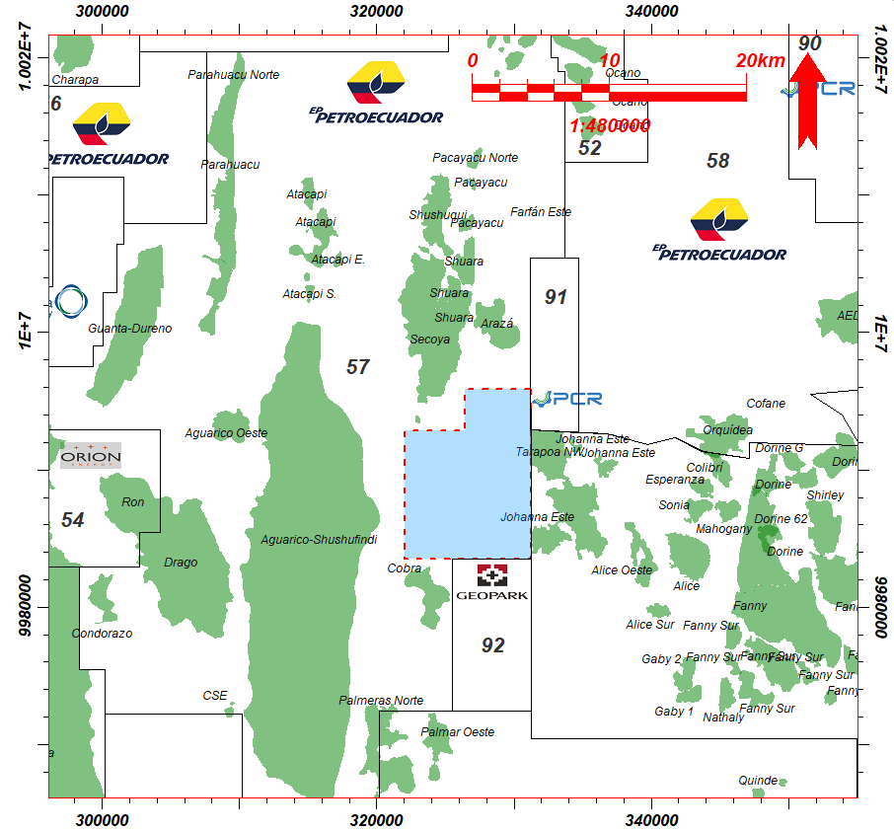

TAMYA BLOCK
15
Location: North-central Oriente Basin between the Shushufindi fields and the Libertador complex.
Approximate area: 9,957.2 Ha.
Prospective reservoirs: M-1 Sandstone, U Sandstone.
Prospects: Tamya, Tamya Northeast, Tamya Southeast, Tamya South.
Estimated POES: 54.90 MMbls
Estimated Prospective Resources: 17.27 MMbls
Expected API: 18°- 22°
Existing wells: 0

Slide 16
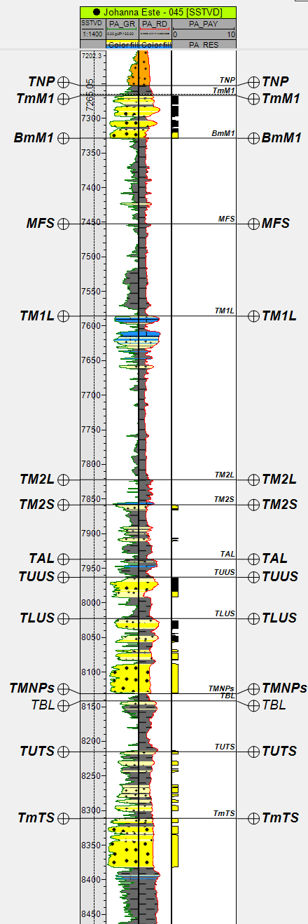
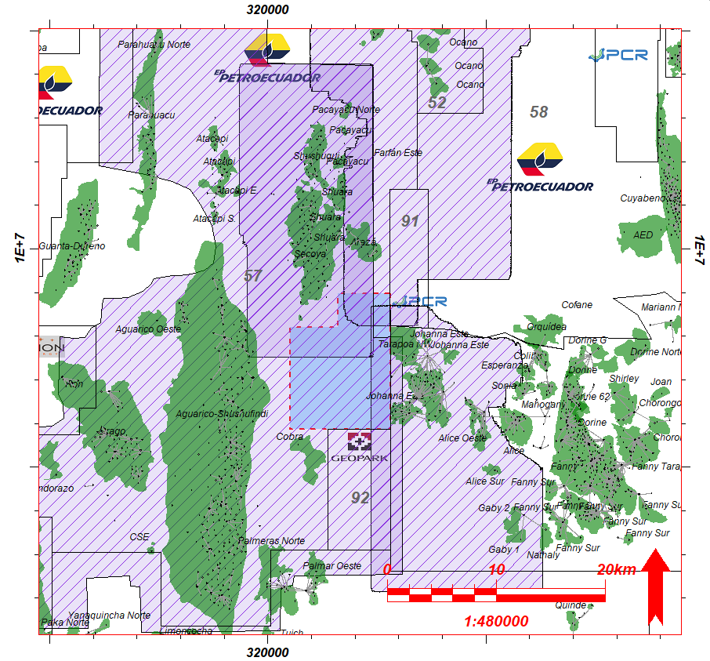
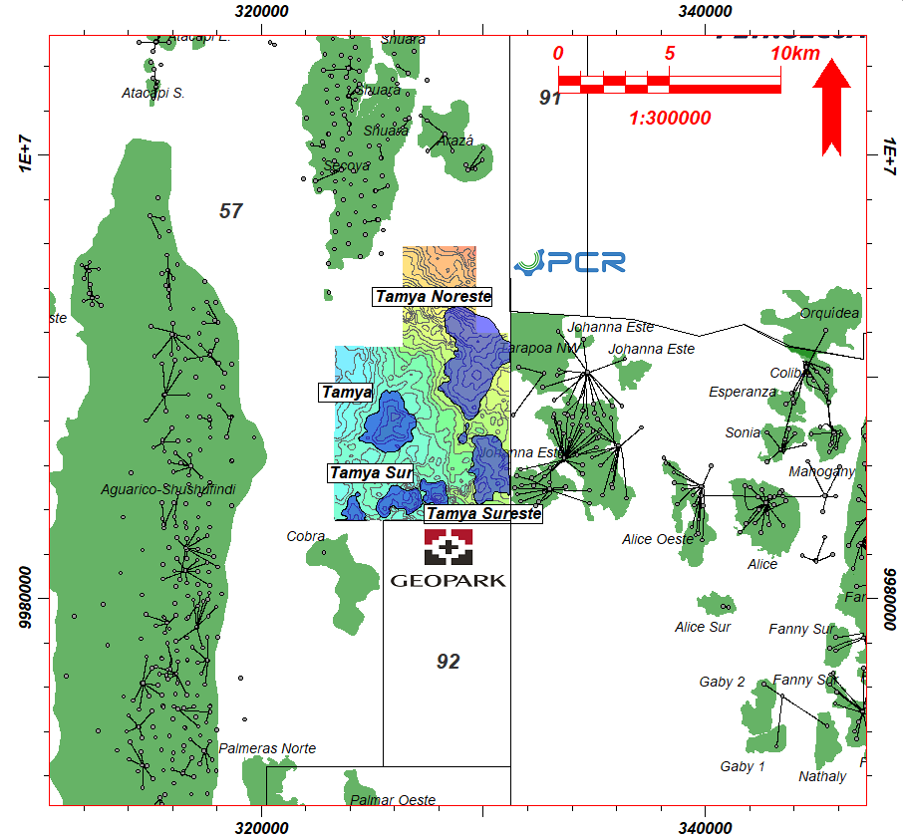
TAMYA BLOCK
TYPE WELL
16
3D SEISMIC CUBE
STRUCTURAL DISTRIBUTION

Slide 17
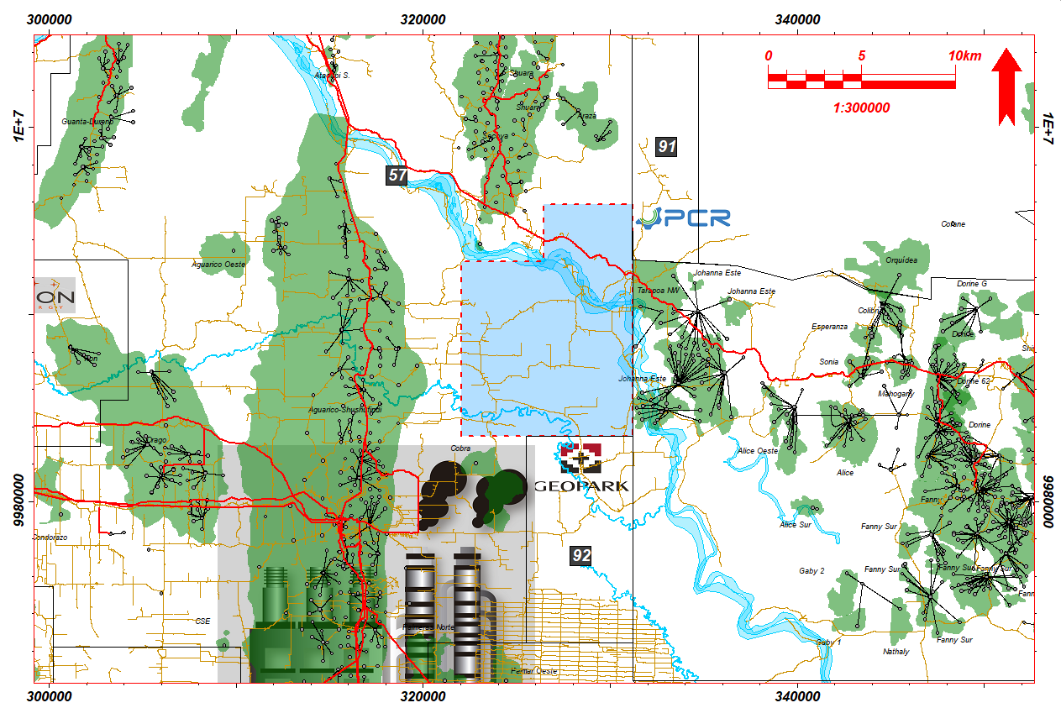
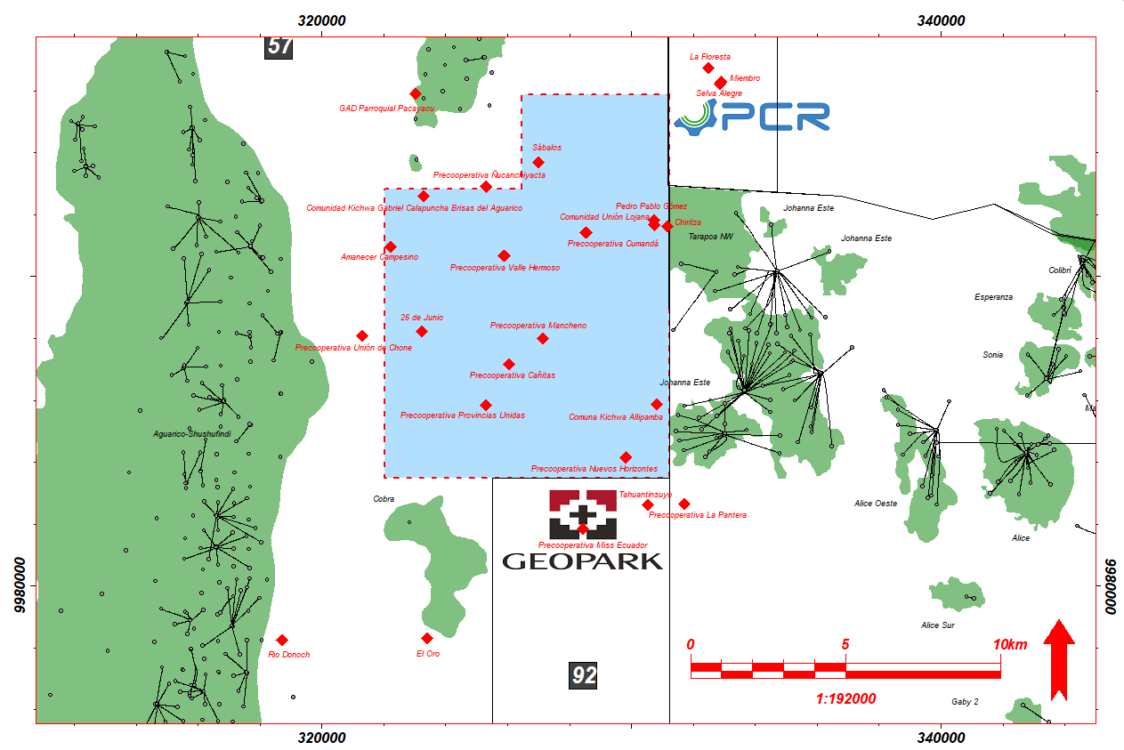
TAMYA BLOCK
17
LOGISTICS AND SURFACE FACILITIES
TOWNS AND COMMUNITIES # 14

Slide 18
TETETE SUR BLOCK

Slide 19
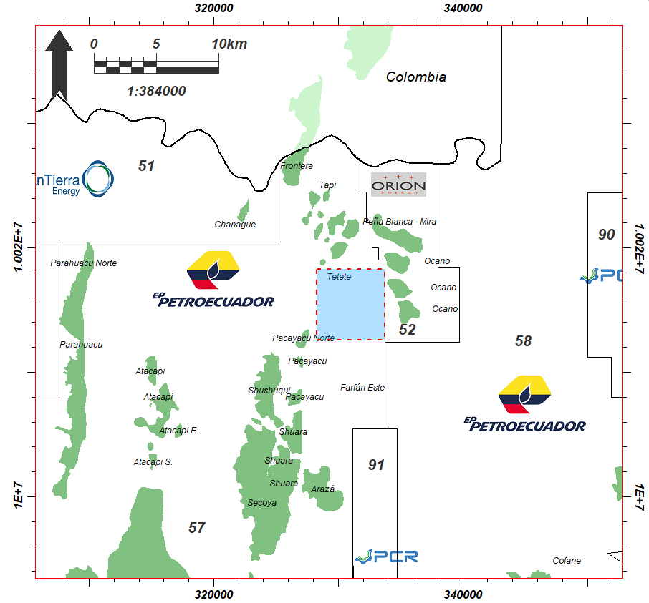

TETETE SUR BLOCK
19
Location: North-central Oriente Basin between Blocks 52, 57 and 58.
Approximate area: 3,096.2 Ha.
Prospective reservoirs: Lower U Sandstone, Lower T Sandstone.
Prospects: South Tetete.
Estimated POES: 13.68 MMbls.
Estimated Prospective Resources: 4.60 MMbls
Expected API: 22°- 26
Existing wells: 0

Slide 20
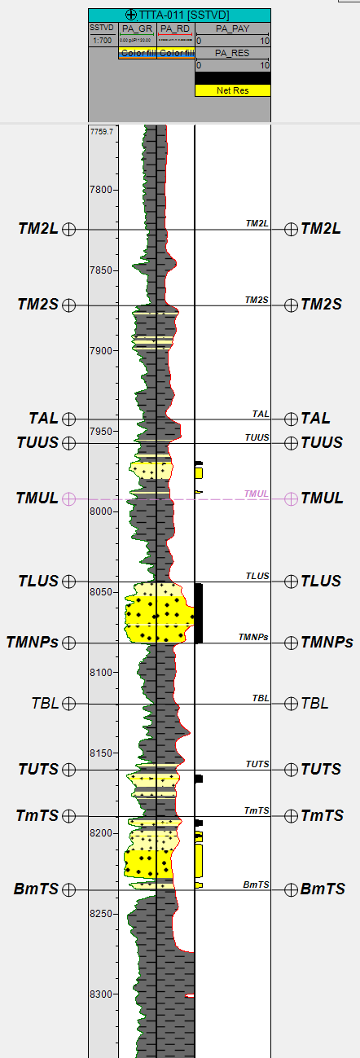
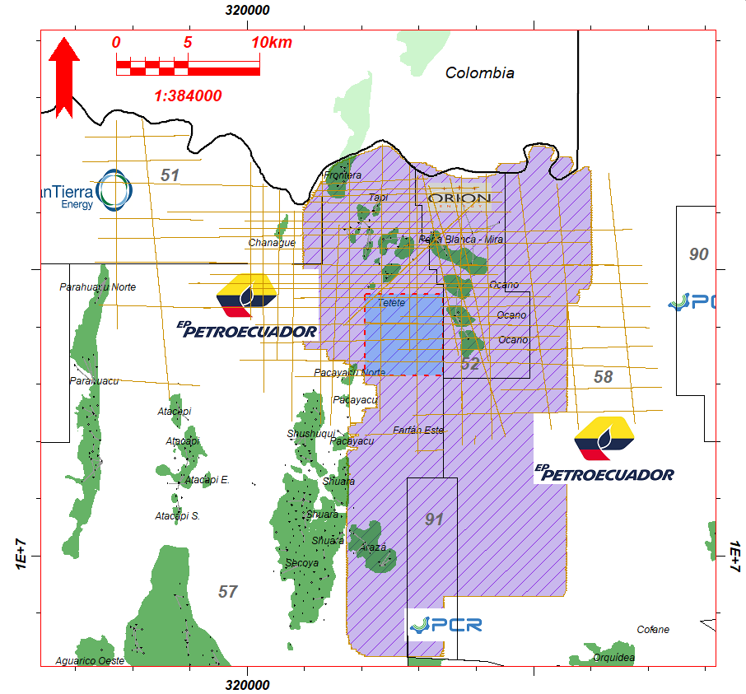
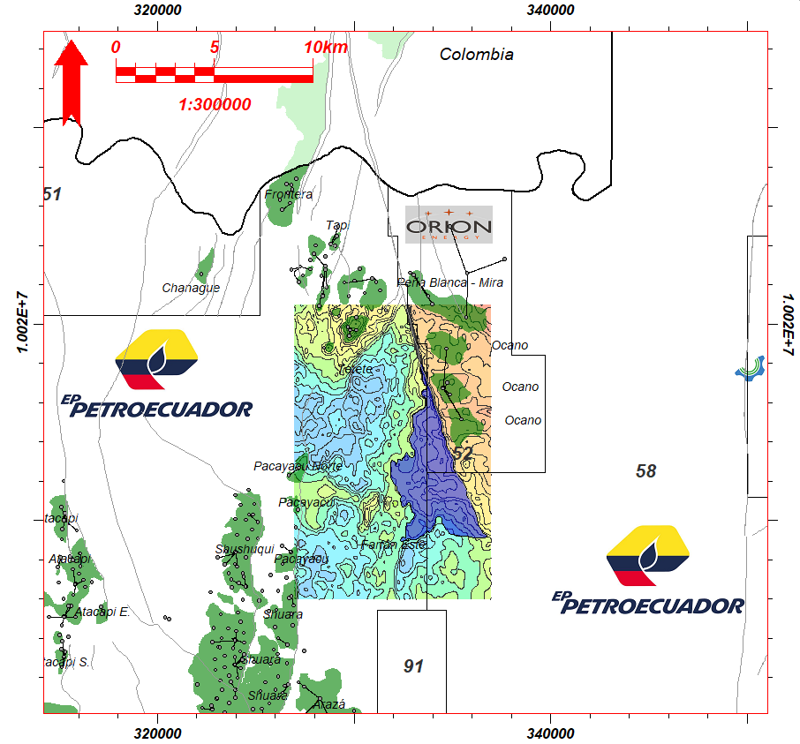
TETETE SUR BLOCK
TYPE WELL
20
2D SEISMIC LINES and 3D SEISMIC CUBE
STRUCTURAL DISTRIBUTION

Slide 21
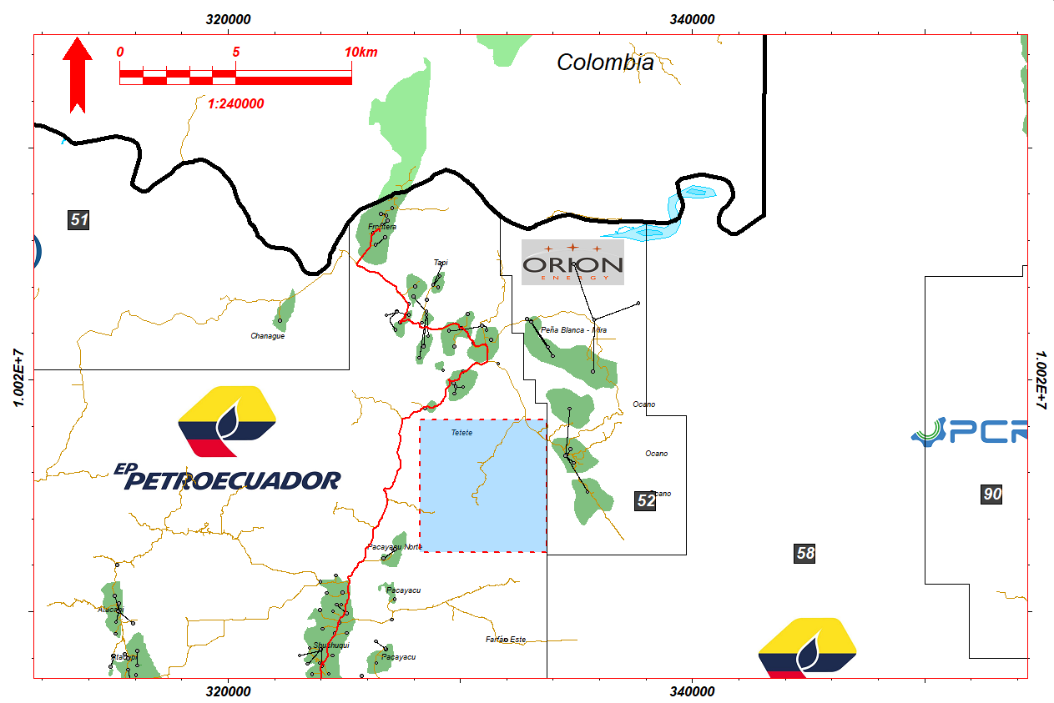
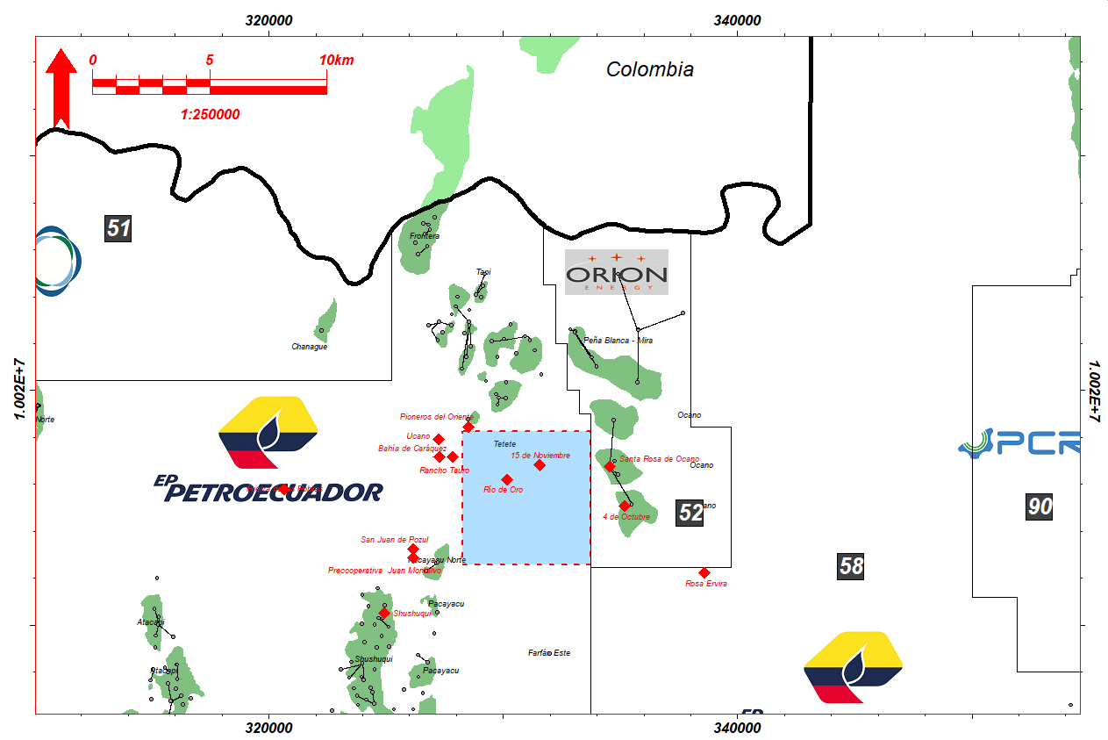
TETETE SUR BLOCK
21
LOGISTICS AND SURFACE FACILITIES
TOWNS AND COMMUNITIES # 2

Slide 22
VHR EAST / VHR WEST BLOCKS

Slide 23
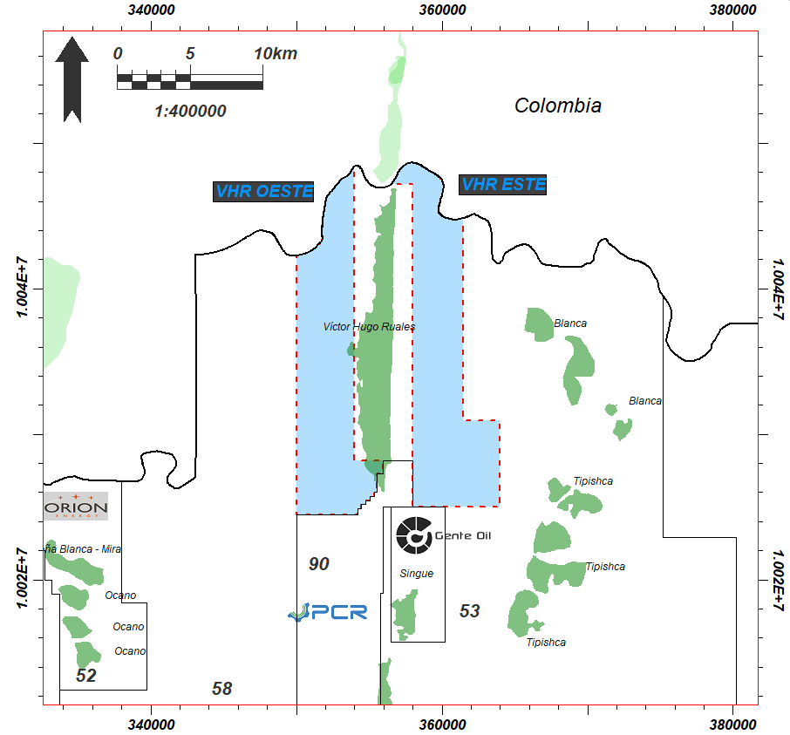

VHR EAST/ VHR WEST BLOCKS
23
Location: Center-North of the Oriente Basin between Blocks 58, 90 and 53, and to the North with Colombia.
Approximate area: 8,913.9 Ha (VHR West) and 9,138.8 (VHR East).
Prospective reservoirs: Basal Tena Sandstone, M-1, M-2, U, T.
Prospects: VHR-O North, VHR-O Central, VHR-O South, VHR East, VHR Southeast.
Estimated POES VHR West: 41.6 MMbls : Estimated Prospective Resources: 9.85 MMbls.
Estimated POES VHR East: 186.4 MMbls : Estimated Prospective Resources: 33.68 MMbls
Expected API: 21°- 28°.
Existing wells: 0

Slide 24
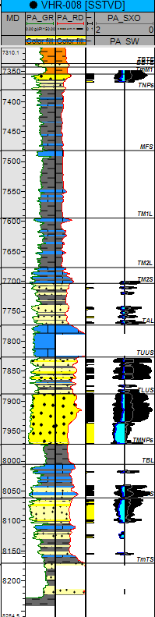
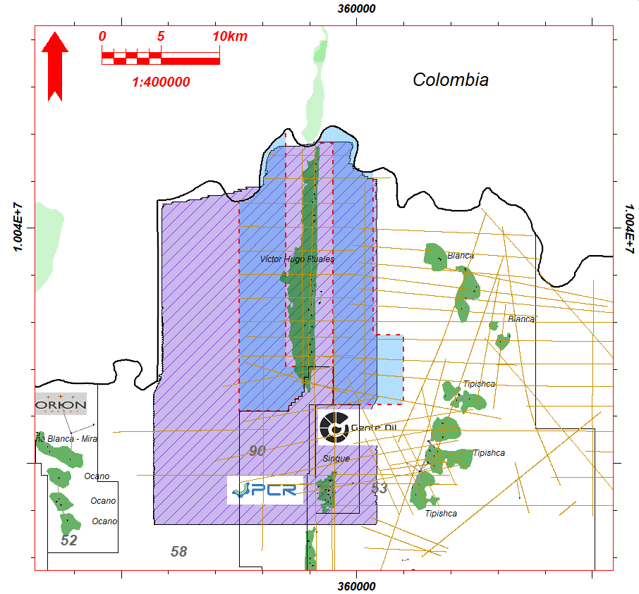
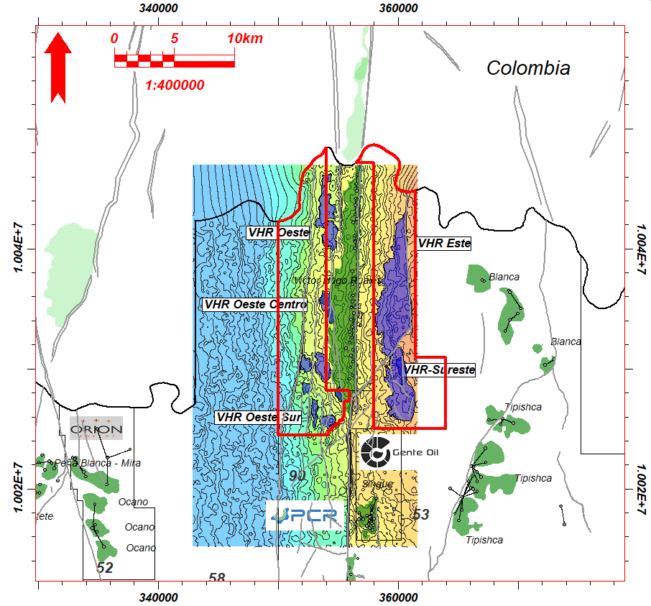
VHR EAST/ VHR WEST BLOCKS
TYPE WELL
24
2D SEISMIC LINES and 3D SEISMIC CUBE
STRUCTURAL DISTRIBUTION

Slide 25
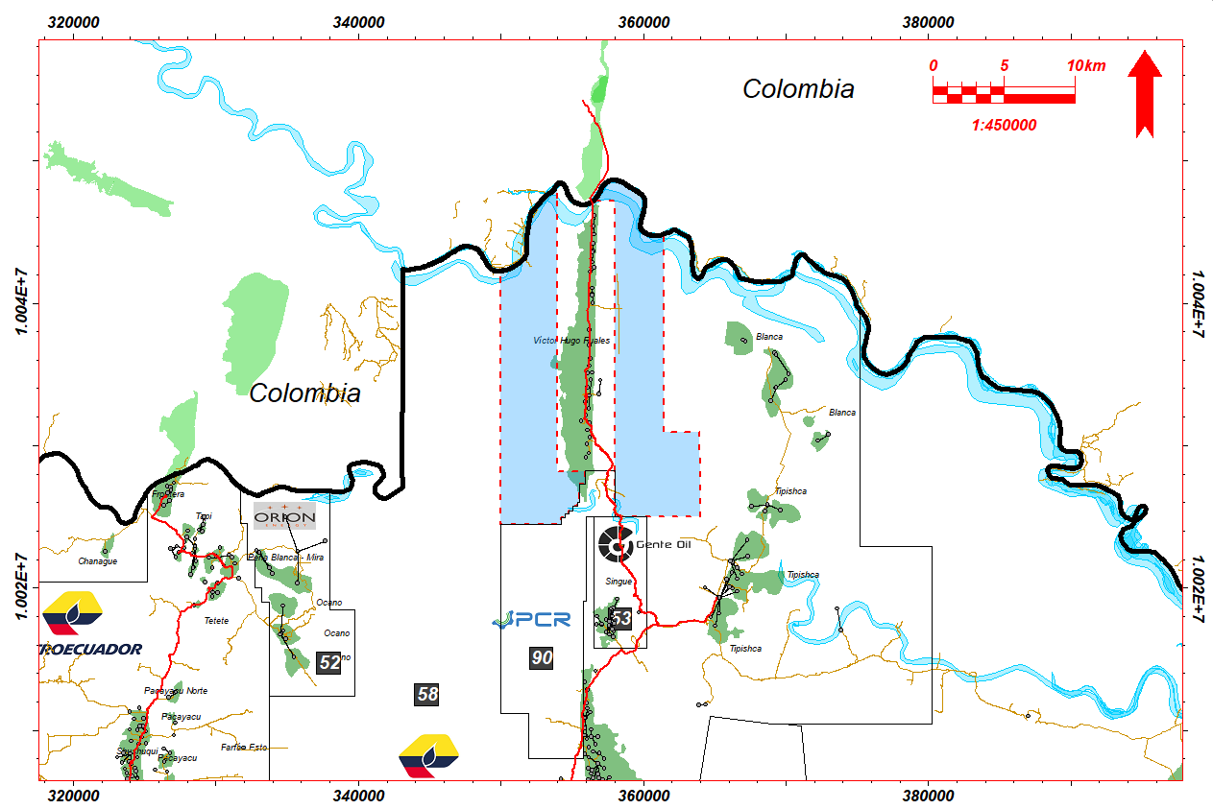
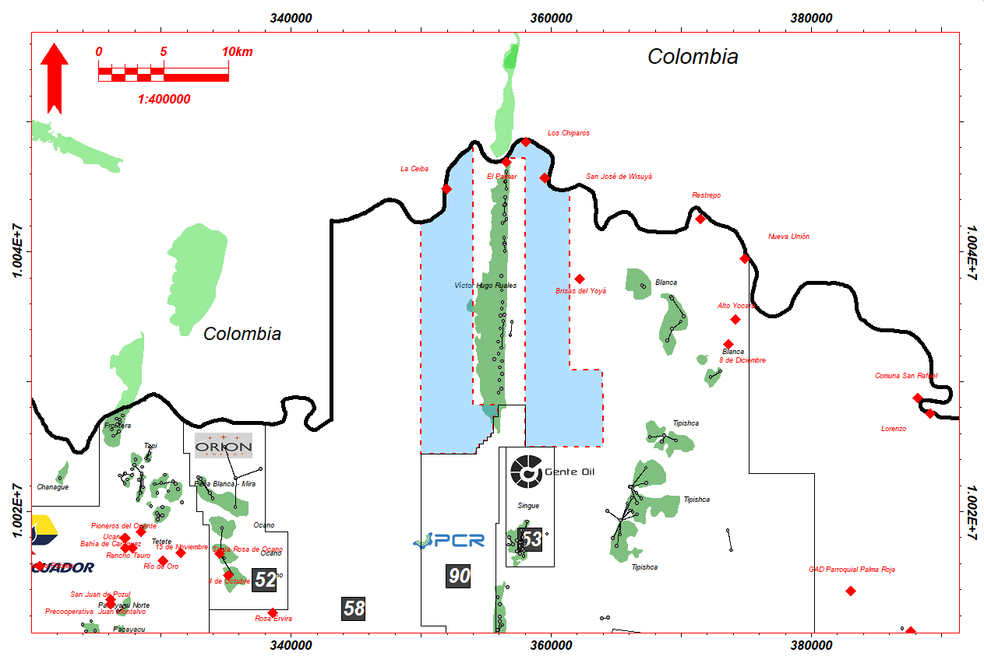
VHR EAST/ VHR WEST BLOCKS
25
LOGISTICS AND SURFACE FACILITIES
TOWNS AND COMMUNITIES # 3

Slide 26
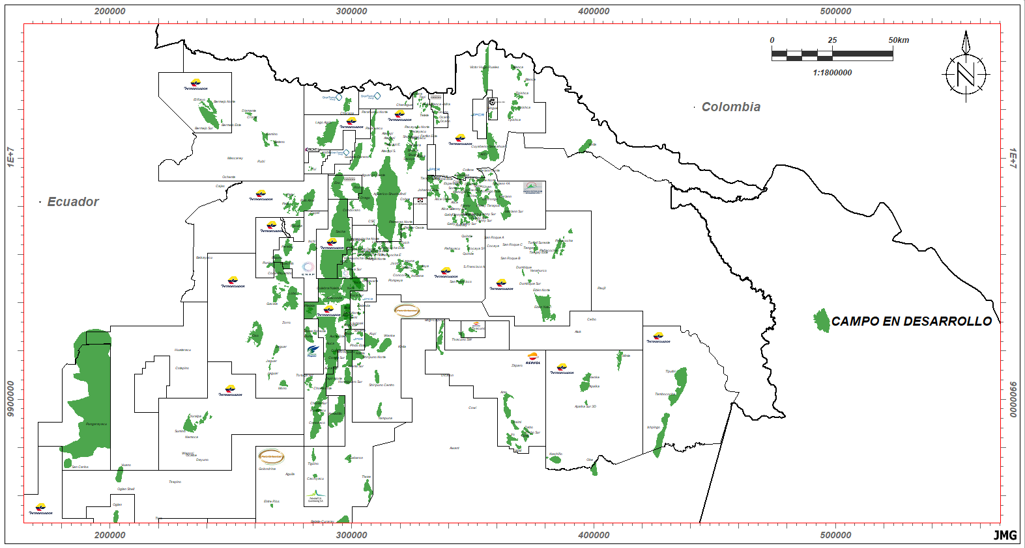
NORTHEASTERN ECUADORIAN OIL FIELDS

Slide 27
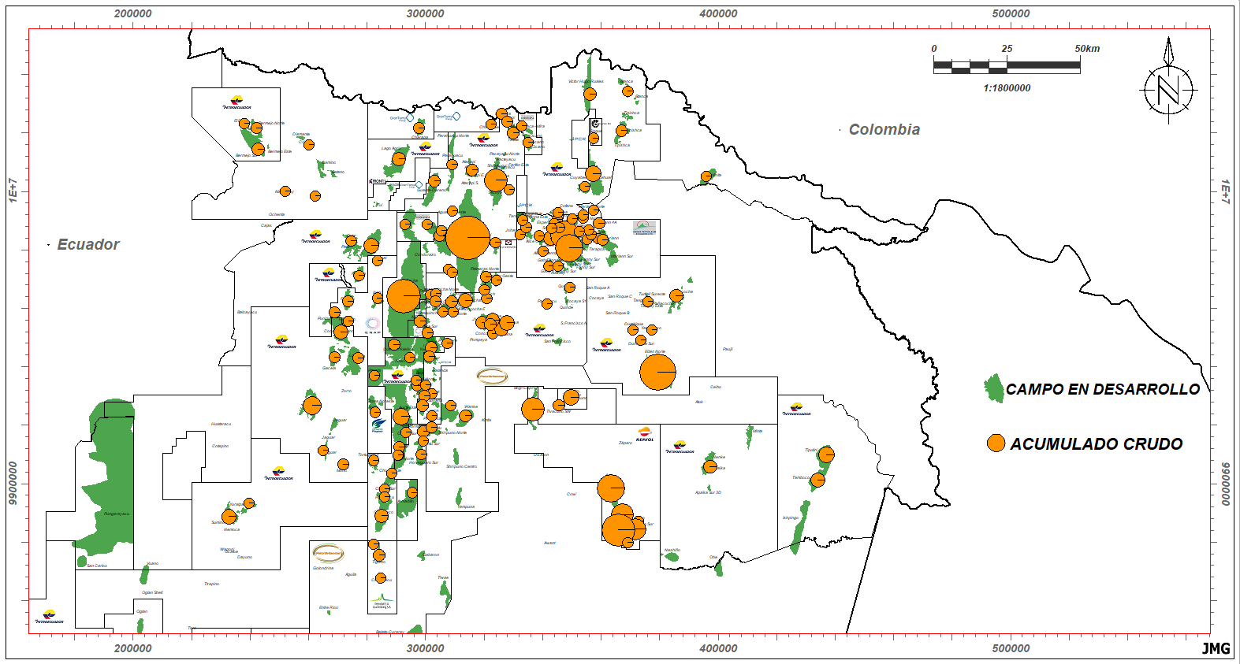
NORTHEASTERN ECUADORIAN OIL FIELDS

Slide 28
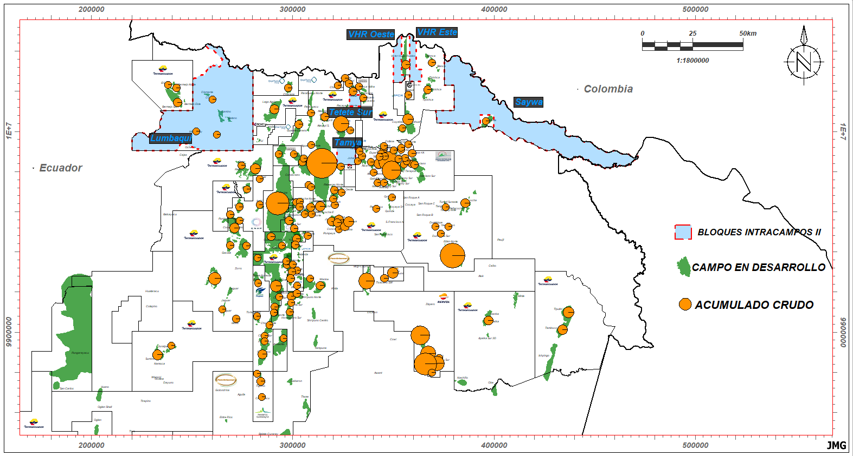
NORTHEASTERN ECUADORIAN OIL FIELDS

Slide 29
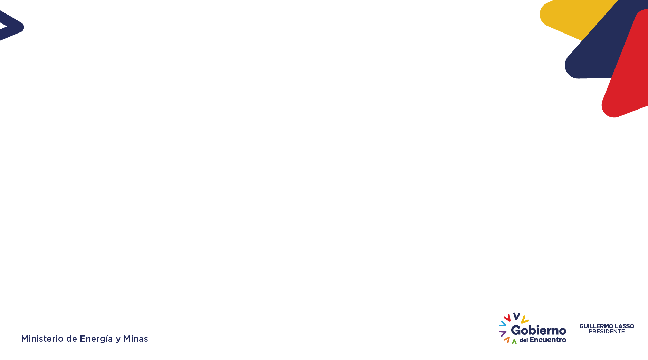
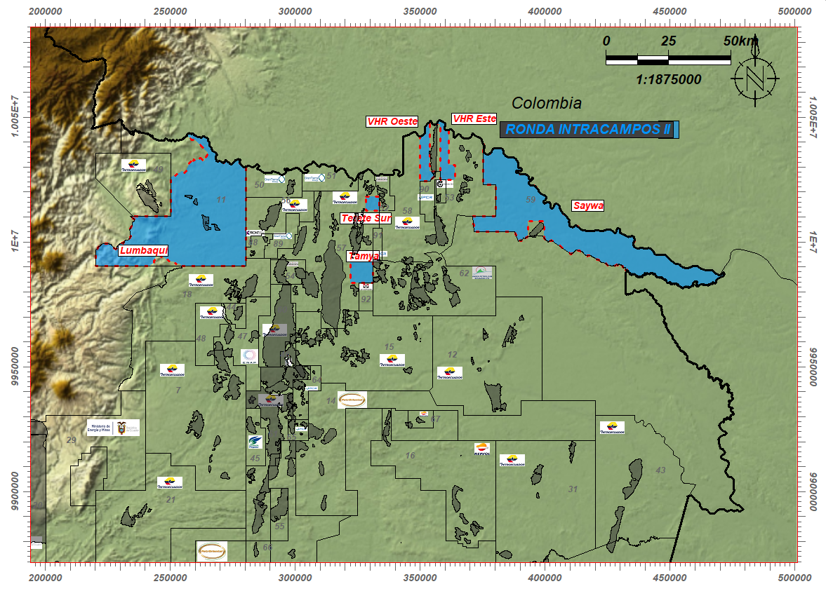
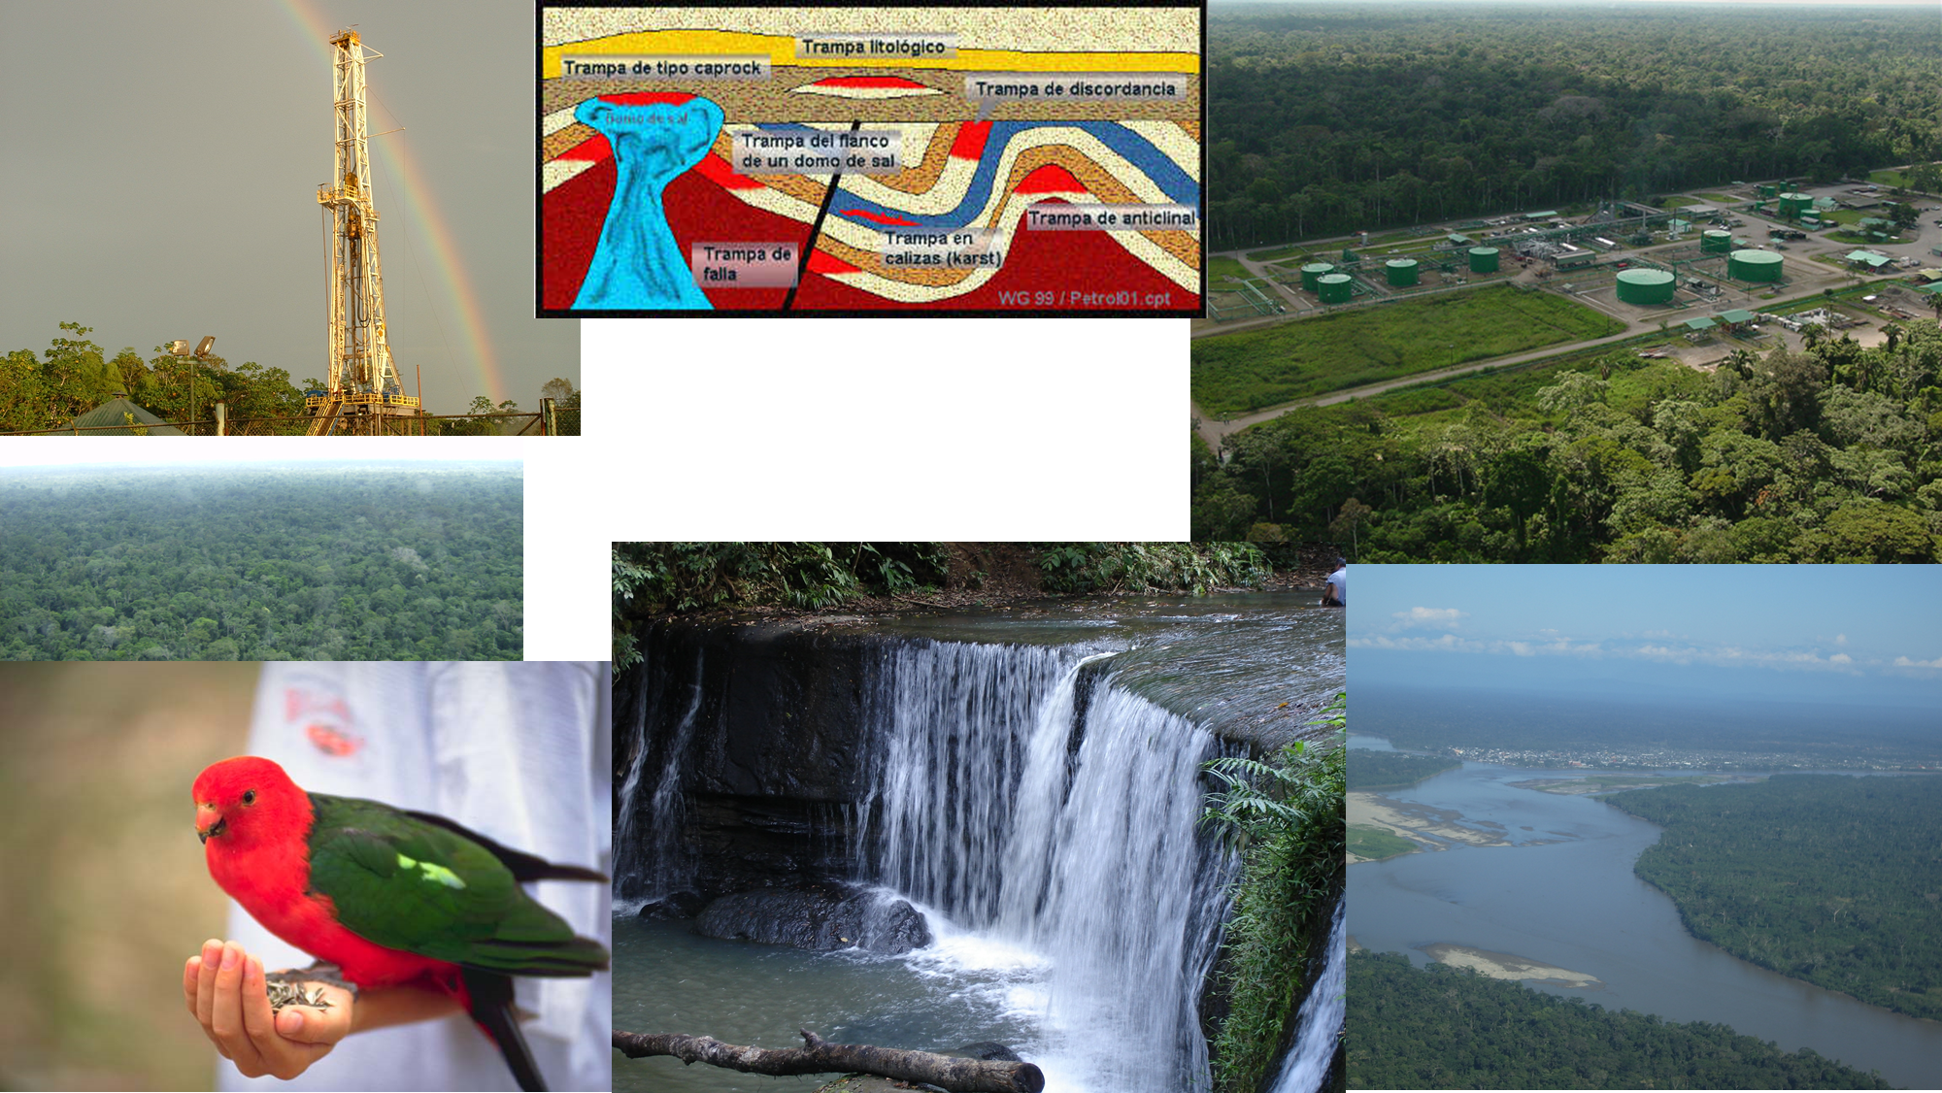


Slide 30
¡Thank You!

