Slide 1





Ministry of Energy and Mines
Houston | October 2022

Slide 2
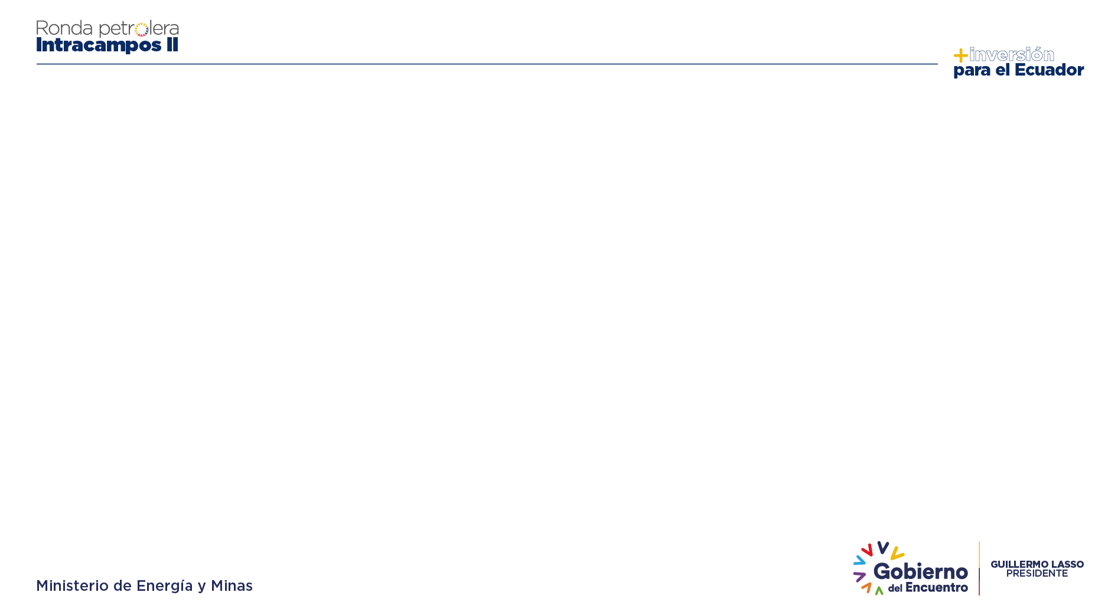






AGENDA
01
PRE-CONTRACTUAL DOCUMENTS
02
EXPLORATION AND EXPLOITATION PERIODS
03
CONTRACT GUARANTEES
04
SOCIO-ENVIRONMENTAL MANAGEMENT
05
DISPUTE RESOLUTION
Notes:
DISPUTE RESOLUTION

Slide 3





PROCUREMENTS DOCUMENTS
Contracting Rules
Instruments for the registration and qualification of companies
Instruments for the Evaluation and Qualification of Offers
tas
Draft Participation Contract
Conditions and procedures for the registration and qualification of companies
Methodology for the evaluation of tenders to determine the order of priority
Methodology for the evaluation of tenders to determine the order of priority
General Guidelines for Procurement
Notes:
CONTRACTING RULES

Slide 4







APPLICABLE REGULATIONS
Constitution
International Agreements
Principles that regulate the hydrocarbon exploration and exploitation industry in the country
Environmental principles regulating oil activity and relations between States.
Laws
Regulations
Establish and regulate the bidding process and the execution of the contract
Participation Contract
Technical parameters for the execution of the contract
Decree 342
Pre-contractual Documents
Regulates the participation contract
.
General guidelines for the allocation of areas

Slide 5

EXPLORATION AND EXPLOITATION PERIODS
Exploitation Period
Exploratory Plan
Up to 4 years, extendable for 2 more years.
Corresponds to the Minimum Exploratory Program and the Additional Exploratory Plan Offered
Development Plan
Exploitation Period
Contractors propose the Development Plan to be executed, as a result of the project being economically profitable
20 years, extendable in accordance with article 23 of the Hydrocarbons Law
Notes:
Exploratory Plan

Slide 6
Contract Guarantees
Contract Guarantees
Object
Validity
Value
Headquarters Guarantee
Declarative guarantee of the Headquarters for the fulfillment of all the obligations of the contract. Applies to affiliates and subsidiaries.
Duration of the Contract
For the total amount of investments.
Exploration Period Guarantee
Ensures the satisfactory execution of the obligations of the Exploration Period.
20% of all estimated investments corresponding to the activities it undertakes to carry out during the exploration period and which are included in the minimum exploratory plan.
Valid for the duration of the exploratory phase
Operating Period Guarantee
It is reduced annually according to the execution. Return to compliance with the obligations committed for the first 3 years.
20% of the investments it undertakes to make in the first 3 years, which will be reduced in direct proportion to the total fulfillment of the committed annual program or will be returned upon termination of the contract due to lack of commercial production
Ensures the satisfactory execution of the obligations of the Exploitation Period.

Slide 7

ENVIRONMENTAL LICENSING – OPERATOR ACTIVITY
Once the contract with the Ecuadorian State has been signed, the contractor, with the accompaniment of the Ministry of Energy and Mines, must carry out the following activities before the Ministry of Environment:
1
4
5
8
Registration in the Single Environmental Information System
Terms of Reference for the Consultancy that will carry out the Environmental and Social Impact Study
According to the study of environmental significance, execution of the Social Participation Processes (PPS)
Payment of fees for environmental services
The Ministry will accompany the investor in this process
2
3
6
7
Favorable pronouncement by the National Environmental Authority for the issuance of the Environmental License
Project Non-Intersection Certificate
Observations by the National Environmental Authority on the Environmental Impact Study
Preparation of the Environmental Impact Study

Slide 8
¡Thank You!

